Slide 2
2
Watch the video clip
Write down:
    One thing you’ve learnt
    One question you have about what you have seen
Notes:
Students can click on the link on their worksheet to watch the video clip on Youtube.
https://youtu.be/67NBETaVvDk

Slide 3
2
What is a social issue?
  Watch the second video clip
  Based on what you’ve seen, what do you think the definition of a social issue is?
Write down your definition of a social issue.
  Why not share your social issue definition using #MyFirstGive
Notes:
Students can click on the link on their worksheet to watch the video clip on Youtube.
https://youtu.be/3ZLqE7jqj04

Slide 4
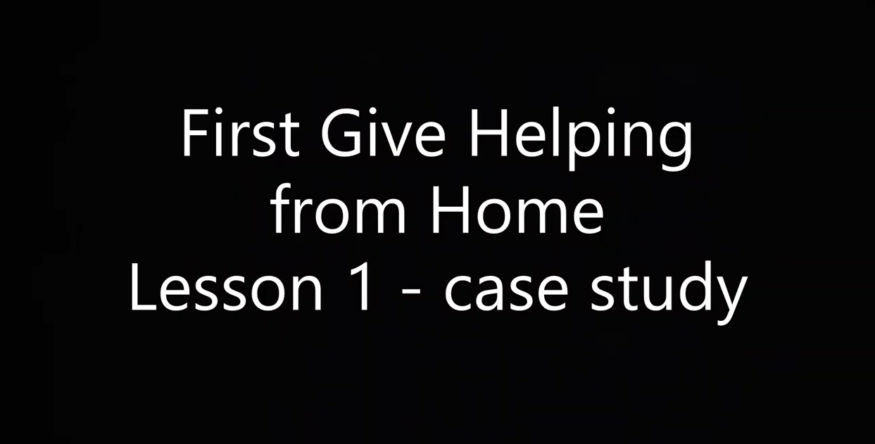

s 4 and 5
Identifying causes and make links
  Read or listen to the case study.
  Identify any social issues and write them in the boxes on your worksheet.
  What are the causes of the social issues? What are the links between them?
Click to follow link to case study on YouTube

Slide 5

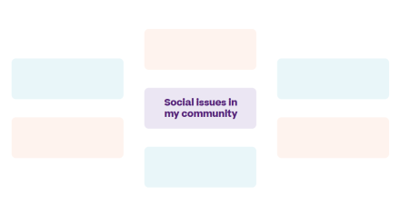
6
Which social issues can you identify in your community?
  Use the diagram on your worksheet to map out as many ideas as you can.
What’s my social issue?
  Decide on an issue that you’ll focus on as a priority.

Slide 6
7
Who’s responsible?
  Now you have chosen your social issue, write down how you think these different groups should address this social issue under normal circumstances.

Slide 7
9
Reflection
  List 2 reasons why it is important to offer support to people affected by this social issue.
  Research and write down one interesting fact about your social issue.

Slide 8
