Slide 1
What is being done currently to help communities?

Slide 2

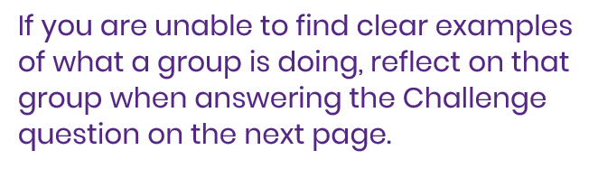
2
Looking back – who’s responsible?
  What social issue did you choose last lesson?
  Look back at the groups you thought about last lesson.
  Use the internet to research one action each group is taking right now. Your answers should relate to your chosen social issue.

Slide 3

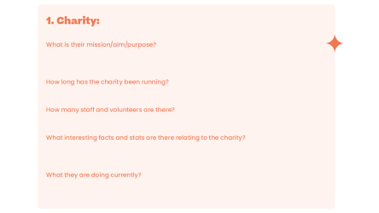
s 4 and 5
What are charities doing?
  Use the guidance on your worksheet to find 3 charities which tackle your social issue.
  Look at their websites and try to answer the questions on your worksheet for each of your three charities.

Slide 4
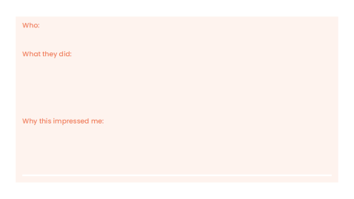
6
Reflection
  In your research and in your day to day you will see things that groups or individuals have been doing to help others.
  Think about the top two things you’ve seen in your research, in real life, in the news or on social media recently.

Slide 5
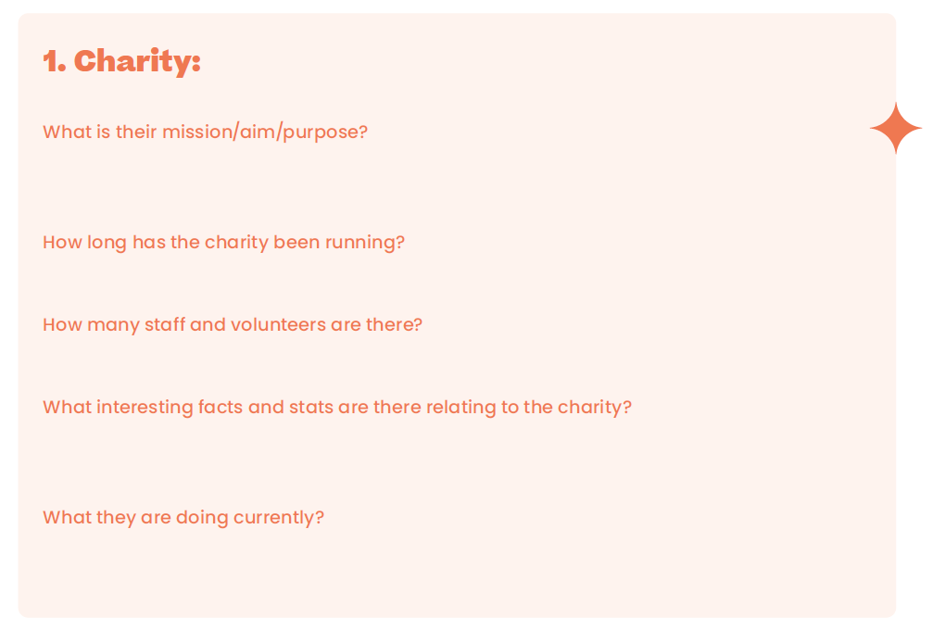

Slide 6


