Slide 2

2
Looking back
  Think about the examples you researched last lesson. What was your favourite one and why?
  Type your answer onto your worksheet.

Slide 3
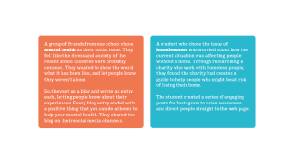

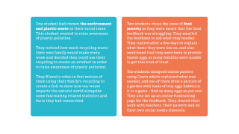
3
Read the social action examples
  Based on these examples, what do you think social action is?
  Social action is:
  Practical action taken to make a positive change in society. For example, fundraising or raising awareness.
  Click on images to enlarge

Slide 4
4
What makes social action successful?
  Answer the 3 questions on your worksheet about the case studies you have read.
  Click on images to enlarge

Slide 5

4
#MyFirstGive
  We want you to take part in the First Give – Helping from Home competition for a chance to win £1,000 for a charity of your choice.
  Read the instructions on your worksheet, and remember to share your social action with us using #MyFirstGive

Slide 6
5
Planning your social action
  Follow the instructions on your worksheet to plan your social action.
  Thinking about what you want to achieve will help you to be more effective. Be specific when deciding what you are going to do.

Slide 7

s 7 and 8
What now?
  Now to carry out your social action plan!
  Make sure you follow the guidance on your worksheet to do this safely.
  Share what you’ve done with us – we are really looking forward to hearing about it!

Slide 8
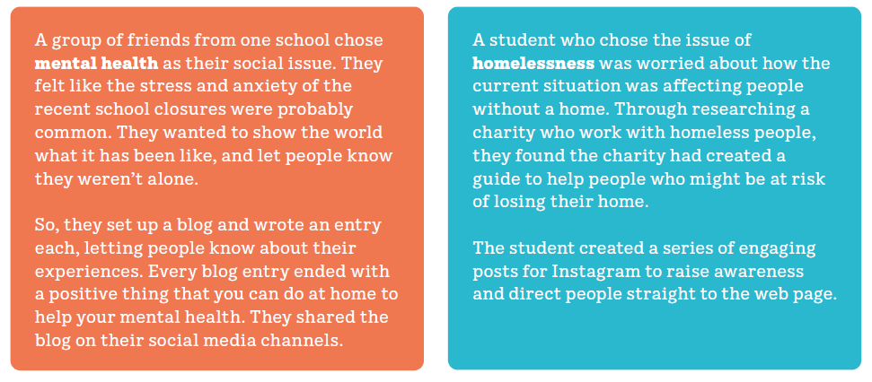

Slide 9
