Slide 1
Notes:
Safeguarding: During the course of this lesson students are asked to discuss social issues. We strongly recommend setting clear ground rules around how to discuss such issues sensitively. Students in your class may have been directly or indirectly affected by the social issues being discussed, and in some cases, students may make a disclosure which should be reported through your school’s safeguarding procedures.

Slide 2
3
Watch the videos
Write down:
One thing you’ve learnt
One question you have about what you have seen

Slide 3
3
What is a social issue?
Based on what you know so far, what do you think the definition of a social issue is?
Write down your class definition of a social issue.
Notes:
Recommended social issue definition: “Social issues are problems that affect members of a community or society as a whole”

Slide 4
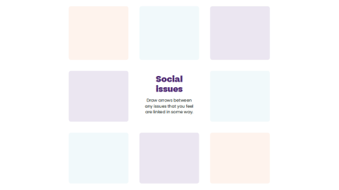
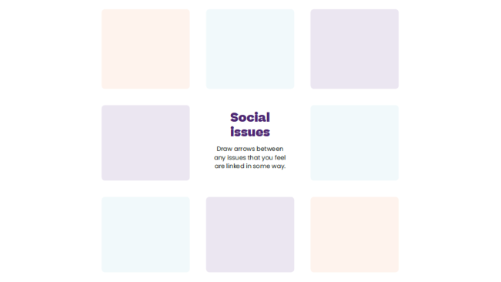
4
Identify causes and make links
Listen to the case study. When you identify a social issue, write it in your coursebook.
Draw arrows between any issues you feel are linked in some way.

Slide 5
5
Who’s responsible?
For this activity, choose one social issue to focus on.
In pairs, discuss how the groups on page 5 of your coursebook should address your chosen social issue.

Slide 6
6
Which social issues can you identify in your area?
You have one minute to work with a partner to list three social issues you’ve noticed in your local community. Be prepared to feed back.
Click to start the timer bar

Slide 7
6
What’s our issue?
As a class, now decide on one issue that you’ll focus on as a priority.
Your teacher will help the class to decide by leading a discussion and a vote.

Slide 8
7
After this lesson how would you rate your…
Understanding of social issues?

Slide 9
