Slide 1
Notes:
A note on charities. In order to be eligible to receive the £1,000 First Give grant charities must be registered with the Charity Commission of England and Wales. The charities chosen must benefit people within the community, who are affected by the social issue chosen in lesson 1. Animal charities should therefore not be selected.
After this lesson please get in contact with the charity that the class has chosen as soon as possible to organise for a representative of the charity to meet the class. To help with arranging this meeting please use these two documents, which can be found on the Teacher Hub:
- Guidance for organising the charity visit
- Template email to charity

Slide 2
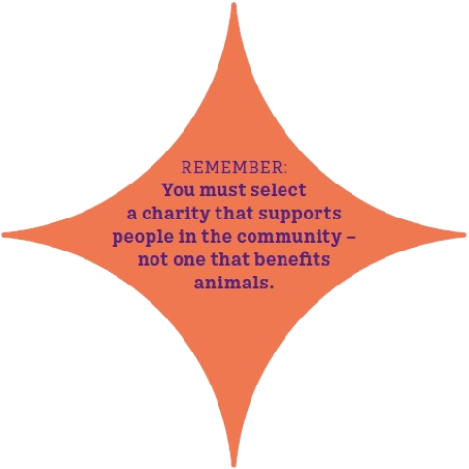
8
1. Finding a charity near you
www.google.com/maps
Go to Google Maps and type in what you’re looking for:

Slide 3
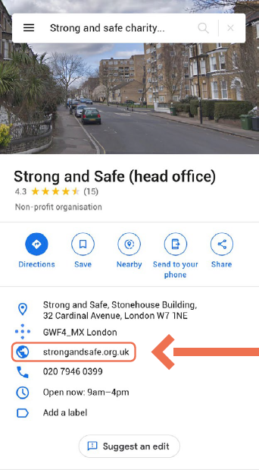
9
2. Click on the charity you want to look at
Their details will show up on the left panel.

Slide 4
9
3. Click on their website
Use this method to look at a few charity websites to ensure you find the right charity for you.
Once you have chosen a charity, you need to check it is registered on the Charity Commission website – follow the steps on the next slide.

Slide 5
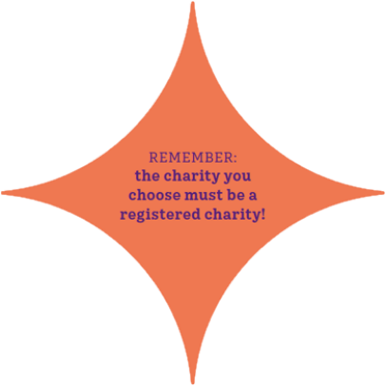
9
4. Look for the registered charity number
This is usually found at the bottom of the “About us” page, or the “Donate” page.

Slide 6
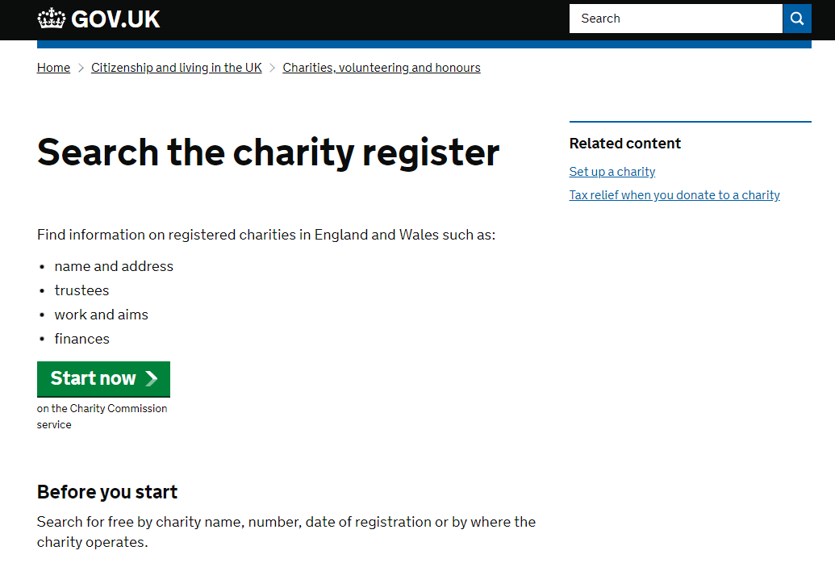
10
5. Go to the Charity Commission website
https://www.gov.uk/find-charity-information
Click on “Start Now”.
Using the search box, enter the charity number you found on the website and click the search icon.

Slide 7
10
6. When on your charity page, check it is green
If there is a red cross, this suggests the charity may not be run efficiently.

Slide 8
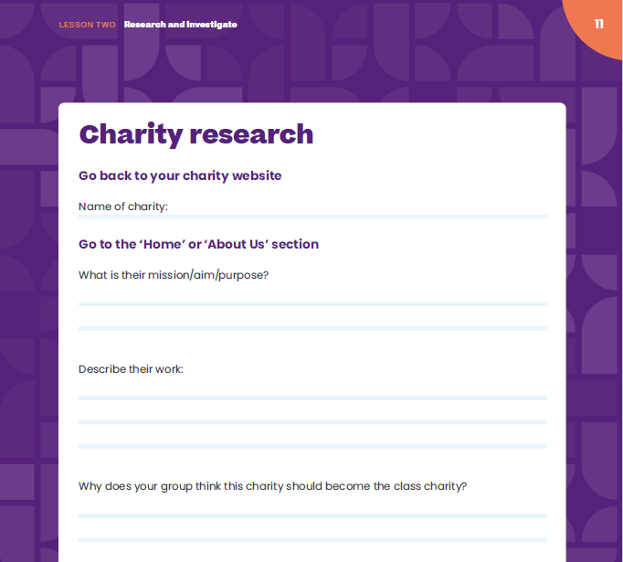
11
Charity research
Go back to your charity website.
In your group decide on one charity you think the class should choose to be the class charity and complete the details on page 11.

Slide 9
11
Your charity
Each group will tell the class about their suggested charity. The class will then decide together on one charity…
Notes:
A note for teachers on charities. In order to be eligible to receive the £1,000 First Give grant charities must be registered with the Charity Commission of England and Wales. The charities chosen must benefit people within the community, who are affected by the social issue chosen in lesson 1. Animal charities should therefore not be selected.

Slide 10
11
After this lesson, how would you rate your…
Research skills?
Group decision-making skills?

