Slide 2
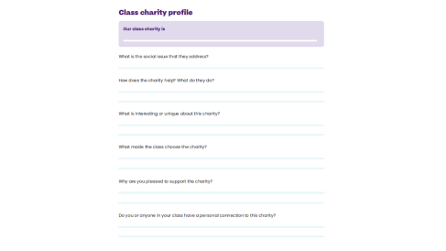
12-13
Our class charity
We are going to create a class charity profile together using the charity website.
Look at the website as a class and fill out the class charity profile on pages 12-13 of your coursebook.

Slide 3
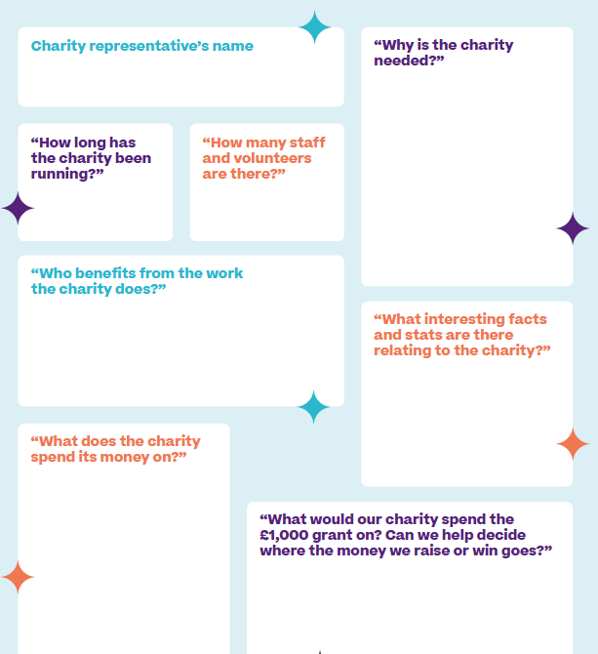
13-15
Charity meeting
Make sure you gather all the information you can to help plan your social action and to include in your presentation.
Use the questions on pages 14-15 and don’t forget to ask any questions you came up with on page 13.

Slide 4
