Slide 2
16
What is social action?
Watch the video

Slide 4
16
What is social action?
Social action is:
Practical action taken to make a positive change in society. For example, fundraising or raising awareness.

Slide 5
16-17
What makes social action successful?
Read through both case studies and answer the questions on page 17 of your Coursebook.

Slide 6
23
Judges’ criteria
When the judges make their decision at the Final, 50% of the marks they award will be for your class’ social action.
You can find these criteria on page 23 of your coursebook. Keep them in mind when planning your social action.

Slide 7
18-19
Your aim
In groups, use the planner on page 18 to think about what you want to achieve.
Your planner
Once you know your aim, think about how you are going to work as a team to achieve it. Use the planner on page 19 of your coursebook.

Slide 8
21
After this lesson, how would you rate your…
Project planning skills?
Leadership skills?
Teamwork skills?

Slide 9
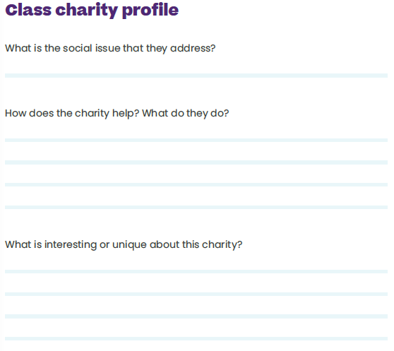

Slide 11
