Slide 1
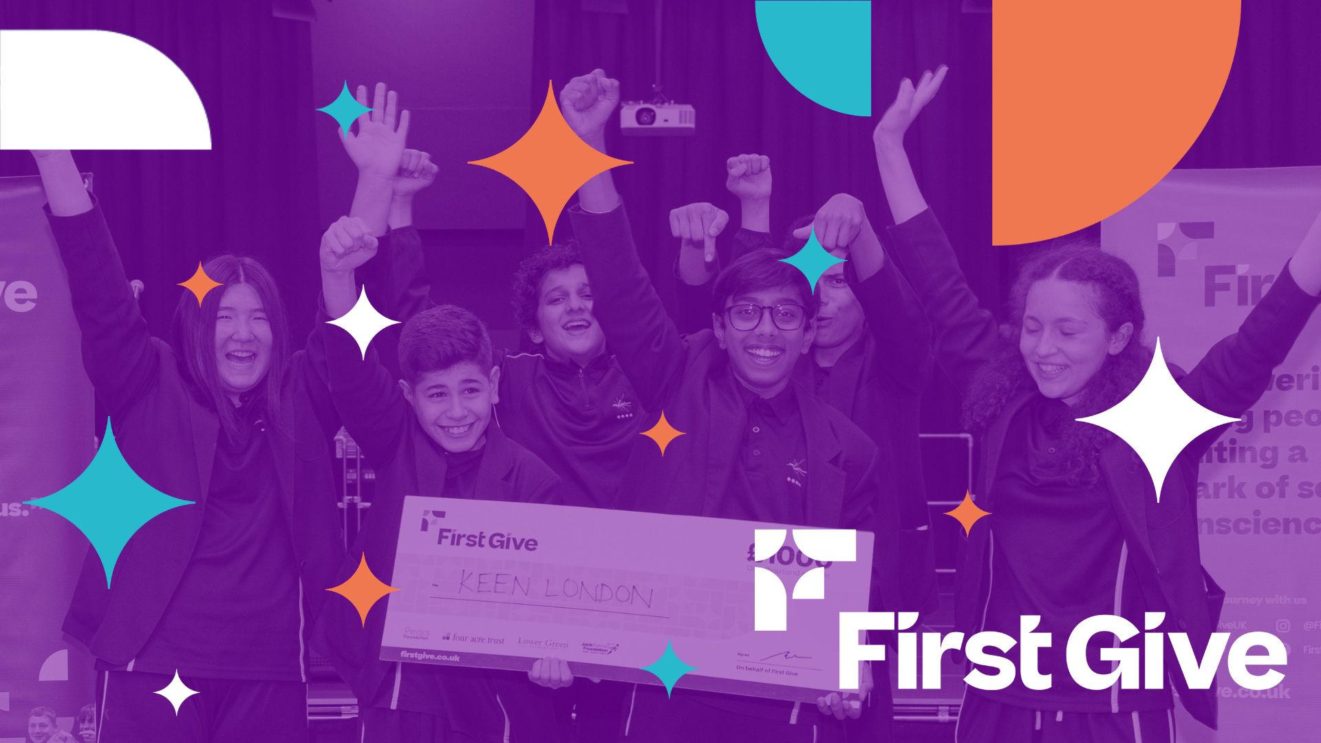
Choose Your Own Social Action Guide 2025/26
Social Action Matrix (1)
Social Action Matrix (2)
Notes:
This resource has been created to inspire social action ideas for your learners in lesson 4.
There are two matrices: (1) and (2)
You may want to ask half your colleagues in the delivery team to use matrix 1 and the other half to use matrix 2 to ensure different ideas are sparked across the year group. Alternatively your students in each class could look at matrix 1 and 2 and divide ideas up between them as a class.
Instructions for use
Start with the Idea formulation slide 2.
For Matrix 1- Move to slide 3 and ask your students to select the social issue they've chosen as a class. This is hyperlinked and will take you to a social action idea that gives ideas and identifies impact.
For Matrix 2- Move to slide 4. The same instructions follow as for Matrix 1.
At the bottom left of each slide you will see a FINAL THOUGHTS or RETURN button. These are hyperlinked so click on FINAL THOUGHTS to go to the Final Thoughts slide 31 or RETURN to go back to slide 1 to select another matrix.

Slide 2

Start with an issue that means something to you and consider what you could do to support your local community
Ask your teachers and trusted adults for inspiration and additional ideas
Ask your charity representative in your meeting and any follow-ups (pages 14 and 15 in student coursebooks)
Use the plan in your student coursebook (page 18 to 19)
Review your chosen charities website to get inspiration for social actions that may already have been carried out
Create a mind-map! Identify your key stakeholders in your local community – what are their needs?
Use the 'stuck for ideas' page in your student coursebook (page 20)
Ask your teacher to look at the 'blog' on the First Give 'Teacher Hub'
Have another look at the judges' criteria in your student coursebook (page 23)
Return
Idea Formulation Strategies

Slide 3
Idea Formulation Strategies
Army and Ex-Services
Community Cohesion
Disability
Gender Based Violence
Environment
Education, Employment, and Training
Health
Housing and Homelessness
Human Rights
Sport and Recreation
Old Age / Elderly
Mental Health
UK Poverty Relief
Final Thoughts
Return
Matrix 1 – click an issue for an idea!

Slide 4
Idea Formulation Strategies
Army and Ex-Services
Community Cohesion
Disability
Gender Based Violence
Environment
Education, Employment, and Training
Health
Housing and Homelessness
Human Rights
Sport and Recreation
Old Age / Elderly
Mental Health
UK Poverty Relief
Final Thoughts
Return
Matrix 2 – click an issue for an idea!

Slide 5
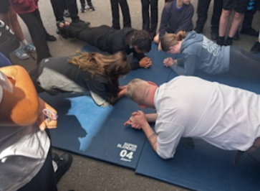


Social Action Idea
Host an action-packed Community Fun Day
Link it to physical challenges inspired by military-style training
Activities could include tug-of-war, tyre flipping, relay races, mini assault courses, and family-friendly boot camp sessions
Impact
Improves the mental health of participants
Showcases the benefits of participating in physical activity
Creates teamwork opportunities
Creates fundraising opportunities through sponsorship
How could you make this idea your own?
Final Thoughts...
Army and Ex-Services

Slide 6
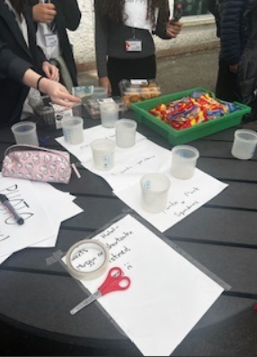
Social Action Idea
Create a vibrant school display.
Fill it with positive messages, kind words, and uplifting artwork
Get the Art department involved to help design posters, illustrations, and creative pieces that promote kindness and unity
Impact
Spreads positivity and supports a great cause
Creates new friendships and connections
Encourages people to 'speak out'
Positive affirmations to improve mental health and wellbeing
What type of messages would make your day brighter?
Final Thoughts...
Community Cohesion

Slide 7
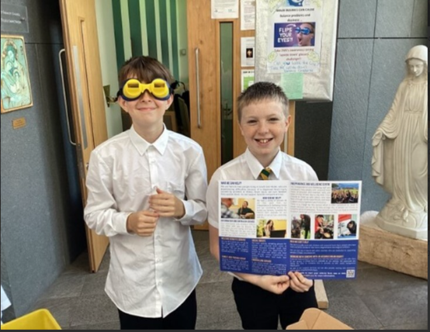
Social Action Idea
Organise a "Sponsor Your Senses" challenge
Participants experience everyday tasks while simulating a disability
For example, wearing blindfolds to simulate visual impairment
For example, using earplugs to understand hearing loss
Impact
Raises awareness of the challenges faced by people with disabilities
Encourages inclusive thinking
Participants could collect sponsorships for completing their tasks
Consider the different ways in which society could make the world more accessible for people with disabilities...
Final Thoughts...
Disability

Slide 8
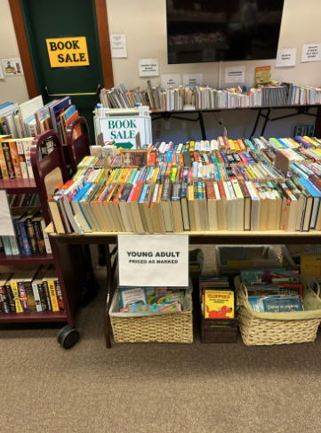
Social Action Idea
Organise a book collection and focus on a specific theme – such as mental health or career inspiration
Donate books to your school or local library
Host a fundraising element alongside the drive – such as a sponsored reading challenge or "pay as you feel" book stall
Impact
Promotes learning
Sparks conversation
Makes a lasting impact on your community
Encourages students and families to donate gently used or new books that help educate and inspire others
What is the best way to advertise this idea to people in your school?
Final Thoughts...
Education, Employment, and Training

Slide 9
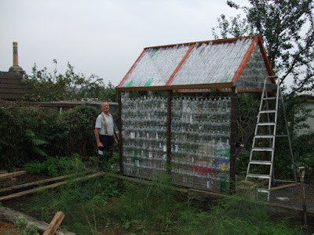
Social Action Idea
Collect used plastic bottles around school and repurpose them into a sustainable greenhouse structure
Use the greenhouse to grow plants, herbs, or vegetables for the school community
Run bottle collection competitions between classes and offer "sponsor a panel donations" for the greenhouse build
Impact
Raises awareness about plastic waste, recycling, and sustainable living
Benefits both the planet and the people around you in the long-term
Produce grown in the greenhouse could also be sold with proceeds going towards environmental charities
You'll need to ask your teachers' permission and seek support!
Final Thoughts...
Environment

Slide 10
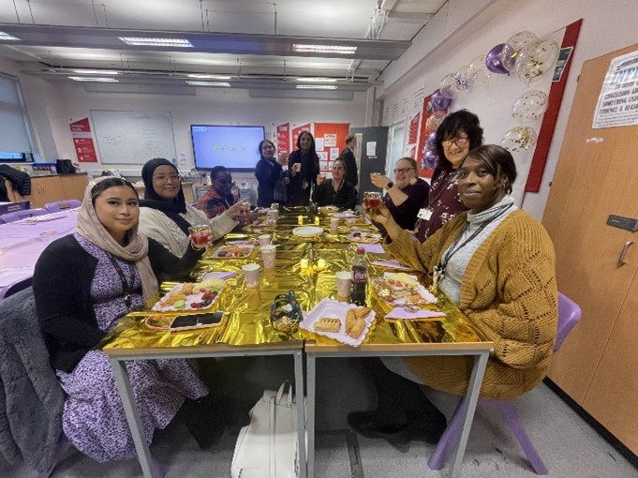
Social Action Idea
Organise a Women's Tea Party event to honour and celebrate the achievements, stories, and contributions of women and girls within the school community
Invite students, staff, families, and local role models to come together over tea, treats, and conversation in a warm and supportive setting
Impact
Why not invite a representative from the charity along so they can give a speech to the attendees?
Empowers, connects, and supports real change
Encourages women to share their fears and worries in a 'safe' and 'supportive' space
Raise funds for gender-based violence charities through donations, ticket sales, or bake sales
Final Thoughts...
Gender Based Violence

Slide 11

Social Action Idea
Organise an official 'Blood Donation Day' in partnership with a local blood donation service
Invite eligible staff, and community members to take part
Sell awareness ribbons or badges
Host a "sponsor a pint" campaign where participants gather pledges for their donation
Impact
Remember to check the eligibility criteria to donate blood on the NHS website!
Inspires action, compassion, and community spirit
Supports the NHS with vital blood supplies
Raises awareness about the importance of regular blood donation in saving lives
Final Thoughts...
Health

Slide 12
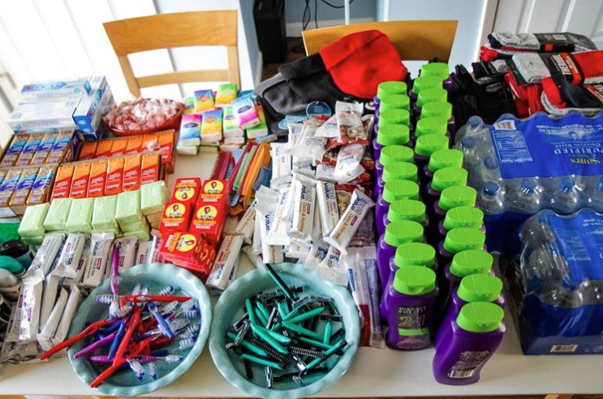
Social Action Idea
Organise the creation and delivery of care packages for local homeless shelters
Each package can include essential toiletries, warm winter items like socks, hats, and gloves, as well as non-perishable food
Host a "sponsor-a-package" donation drive where individuals can cover the cost of one full care pack
Impact
Speak to the charity you are hoping to support. They may have a list of wanted / needed items that you could ask people to kindly donate!
A simple act of kindness that brings warmth, support, and solidarity to those facing housing insecurity
Offering comfort and dignity to those in need
Final Thoughts...
Housing and Homelessness

Slide 13
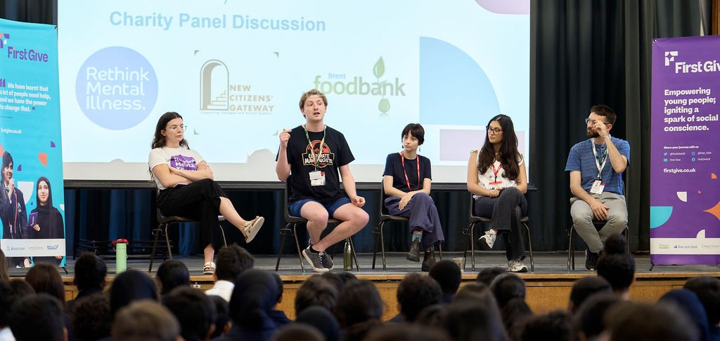
Social Action Idea
Host a student-led debate or discussion panel on an important human rights topic – such as the rights of refugees, freedom of speech, or access to education
Involve participants from different year groups or invite guest speakers, such as local activists or charity representatives, to shared insights and lived experiences
Impact
An empowering way to raise awareness
Encourage critical thinking and equality
Act for global justice
Additional funds could be raised through collecting donations at the event for various humanitarian causes
Why not survey people in your class or year group to see which topics are important to them?
Final Thoughts...
Human Rights

Slide 14
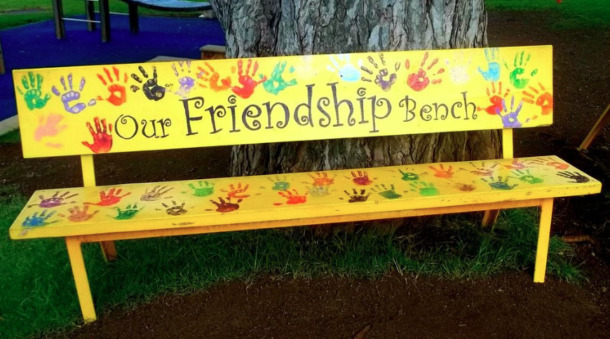
Social Action Idea
Design and create a 'Friendship Bench' for the school playground
Get the Art department involved in the design
Raise funds by running a "sponsor a slat" campaign
Sell handmade friendship bracelets linked to the project
Impact
Simple but powerful way to promote kindness, inclusion, and everyday mental wellbeing
Creates a welcoming space where anyone feeling lonely, or in need of a chat can sit and be invited into conversation
A lasting addition to the school that supports emotional wellbeing for all
If a bench isn't possible, what other way could you ensure there's a new safe space for students at your school?
Final Thoughts...
Mental Health

Slide 15

Social Action Idea
Organise a Christmas card-writing competition to send heartfelt messages to local elderly residents
Host a festive card sales campaign
Run a "sponsor a smile" campaign
Create handmade decorations or small gifts alongside the cards
Impact
Top Tip!
Personalise the cards for that extra special feeling.
Ask your teacher to support you by speaking to the care home manager to learn more about the residents.
A thoughtful gesture that brings joy to others
Reminds us of the value of kindness across generations
Brings comfort, cheer, and a sense of connection to those who may feel isolated during the festive season
Final Thoughts...
Old Age / Elderly

Slide 16
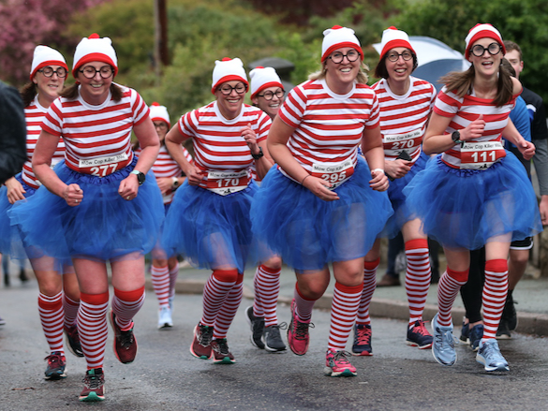
Social Action Idea
Organise a sponsored walk or run for students, staff and families
Choose a fun route around the school grounds, or local park
Set distance options for different age groups or ability levels
Include warm-ups, music, and even themed fancy dress
Gather sponsorships for each lap or kilometre completed
Impact
Make your idea unique!
How could the theme of the activity be linked to your social issue?
A healthy, inclusive way to promote physical activity
Supporting access to sport and recreation for all
Boosts engagement and local community spirit
Encourages people to get active while raising funds for sport and recreation charities
Final Thoughts...
Sport and Recreation

Slide 17
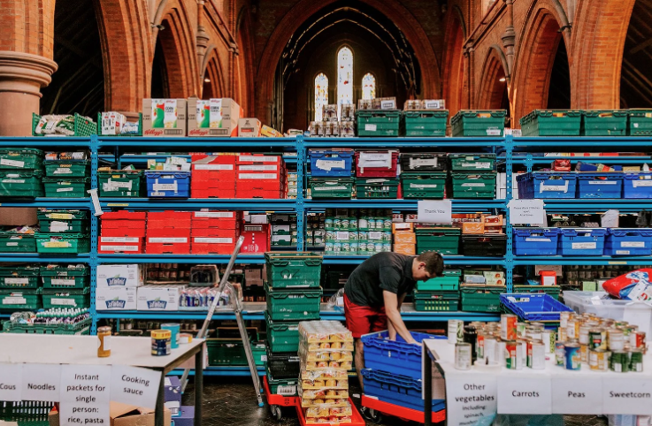
Social Action Idea
Organise a school-wide donation drive to collect essential items for a local foodbank (toiletries, non-perishable food, hygiene products)
Consider running a "reverse" advent calendar during the lead-up to holidays
Consider hosting a "buy a plate to help others fill theirs" competition
Top Tip!
Foodbanks will often have needed items on their social media or websites... Check them to ensure which items are needed by service users.
Impact
A meaningful way to act against poverty and show solidarity with those in need
Donations provide vital support to individuals and families facing financial hardship in your community.
Final Thoughts...
UK Poverty Relief

Slide 18

Social Action Idea
Host a warm and welcoming intergenerational coffee morning at school, inviting a local Armed Forces and veterans' community group to join students, staff, and families
Raise funds through donations for refreshments, a bake sale
Incorporate sponsored activities led by students (e.g. storytelling sessions, performances, or artwork displays)
Impact
Who are your local Armed Forces or Veterans' charity?
Why is it important to celebrate and support our service people?
Improves relationships between younger and older generations in the local community
Combats loneliness
Encourages conversation with veterans sharing their stories and experiences in an informal setting
Final Thoughts...
Army and Ex-Services

Slide 19
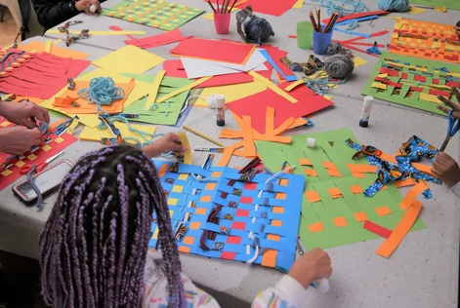
Social Action Idea
Set up a lunchtime club open to all
Offer simple craft activities and light refreshments in a welcoming space
Incorporate weekly kindness challenges such as "say hello to someone new today" or "do a random act of kindness for someone outside of your friendship circle"
Raise funds through selling handmade items or kindness raffles
Impact
Lunch time clubs are a really good way to come together as a group and make new friends with shared interests!
Promotes inclusion and empathy
Provides opportunities for students to meet new people and take a break from their usual routine
A fun and meaningful way to build community from within
Final Thoughts...
Community Cohesion

Slide 20

Social Action Idea
Organise peer-led or staff-supported teaching sessions where participants can learn the basics of British Sign Language
Cover everyday signs like greetings, fingerspelling names, and simple conversations
Encourage donations to attend or suggest a "learn and give" approach where participants contribute after each session
Impact
Use your newly learned skill within your presentation!
Introduce yourself to the judges in Sign Language!
A meaningful way to build understanding and break down communication barriers
Promotes inclusion, communication awareness, and practical skills
Final Thoughts...
Disability

Slide 21

Social Action Idea
Organise a "Skills Swap Fair" where students and staff can run mini sessions teaching other practical or creative skills
For example, budgeting basics, CV writing, interview tips, cooking on a budget, or how to sew a button!
Each participant can sign up to learn a skill or teach one
Raise funds by suggesting a small donation per session, selling resource packs, or hosting a raffle with prizes linked to learning or personal development
Impact
Consider the different ways people like to learn.
What would be interesting to people keen to learn new skills?
Games? Try it yourself opportunities? Videos?
An empowering way to build confidence
Promote lifelong learning
Support access to skills for all
Final Thoughts...
Education, Employment, and Training

Slide 22

Social Action Idea
Host a school-wide clothes swap event where students and staff can bring in good-quality, pre-loved clothing and exchange it for something "new to them"
Ask for a small donation per swap or entry free and set up an eco-stall with tips on sustainable living, upcycling tutorials, or eco-friendly products made by students
Partner with a local environmental charity who will boost your cause further
Impact
Share a fact about the environment with everyone that visits your stall. That's a great way to raise awareness!
A fun, fashion-forward way to care for the planet, and your wardrobe, at the same time
This promotes sustainable fashion, reduces textile waste, and raises awareness of the environmental impact of fast fashion
Final Thoughts...
Environment

Slide 23
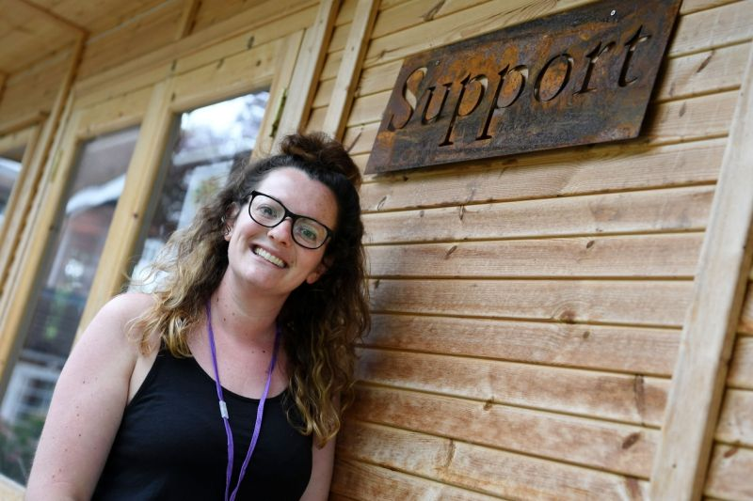
Social Action Idea
Collect necessities, especially toiletries and hygiene products, to donate to a local women's shelter
Host a sponsored walk where participants reflect on the journeys of survivors
Conclude the event with a silent gathering or walk to symbolise the voices that often go unheard
Impact
Think about including items someone would need in an emergency but also products that make us feel good... Self-care is important, especially at difficult times!
A powerful, moving, three-part initiative that raises funds and awareness while standing in solidarity with survivors
Everyday items can make a huge difference for someone starting over in a safe space
Real-life stories and facts educate others about the scale and silence surrounding gender-based violence
Final Thoughts...
Gender Based Violence

Slide 24
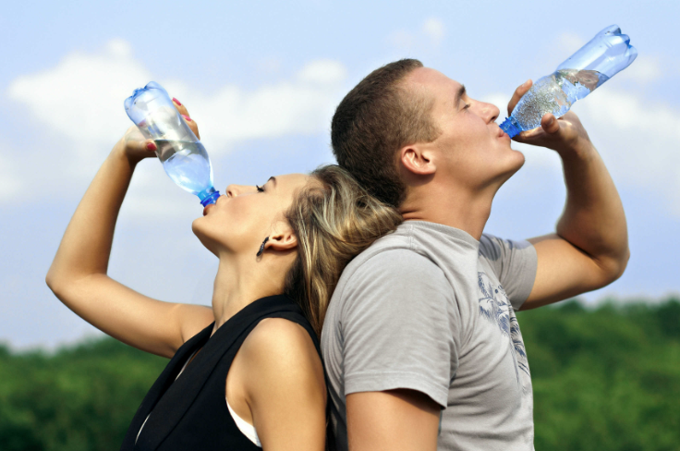
Social Action Idea
Launch a "Healthy Habits Challenge" where students and staff commit to daily health-focused goals
These health-focused goals might include drinking more water, getting 8 hours of sleep, eating 5 portions of fruit and vegetables a day, or taking screen-free breaks
Raise funds by collecting sponsorships or hosting a "Wellbeing Market" with healthy snacks and smoothies made by students
Impact
Track and keep evidence of what you've done for your presentation!
A motivating and educational way to promote healthier lifestyles while supporting vital health causes
Participants can track their progress on a shared wall display or personal challenge cards (to promote personal accountability)
Final Thoughts...
Health

Slide 25
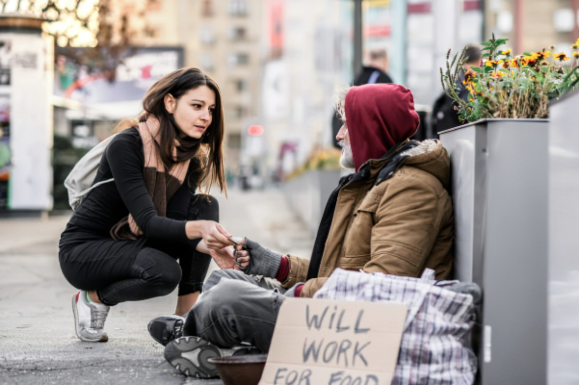
Social Action Idea
Launch a simple but powerful "Smile and Say Hello" campaign in your school
Students can design and wear custom badges with positive messages to prompt friendly greetings
Impact
A feel-good initiative that reminds us of the power of small gestures and helps support those facing much bigger challenges
Highlights the importance of inclusive behaviour to people living on the streets and could really make their already difficult day, just a little better
Encourages kindness, connection, and a stronger sense of belonging to break down social barriers
Let parents and carers know about the campaign through school newsletters and advertise it in assemblies or tutor time!
Final Thoughts...
Housing and Homelessness

Slide 26

Social Action Idea
Host a vibrant World Culture Fundraiser to celebrate the many cultures represented in your school and local community
Include food stalls, music, traditional dress, dance performances, language tasters, and cultural displays
Run donation-based activities like henna art or calligraphy
Raise funds through selling food or cultural items
Impact
Make sure you check and discuss your plans with the senior leadership team at your school!
A joyful and inclusive event that brings people together
Promotes cultural understanding
Supports the fight for human rights around the world
Final Thoughts...
Human Rights

Slide 27

Social Action Idea
Host a welcoming Mental Health Café Club during lunch or after school where students can relax, chat, and access mental health resources
Provide flyers with information about local and national support services for attendees to take away
Complement the Café with a sports challenge event
Impact
A holistic approach combining social support, information, and physical health to promote mental wellbeing in your school community
Creates a stigma-free environment where individuals can discuss their mental health openly
You'll need an adult present, so why not approach your wellbeing team in school to help you!
Final Thoughts...
Mental Health

Slide 28
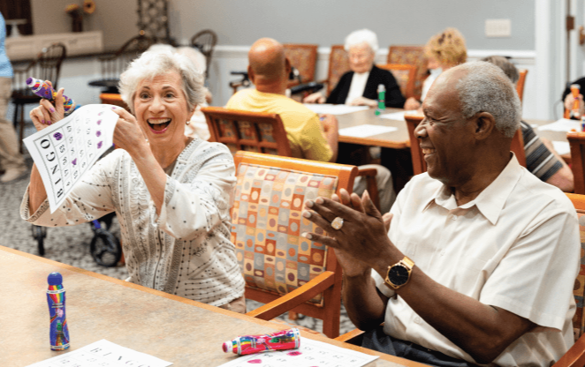
Social Action Idea
Organise a "Memory Lane" storytelling event where students interview elderly members of the local community
Raise funds for elderly charities by inviting donations for attending the event or selling copies of the stories
Compile stories into a digital scrapbook, podcast or display for the school
Host a tea and cake afternoon featuring stories shared live
Impact
Make the event extra special and invite them along as VIPs.
Make it a trip out to remember!
A meaningful way to celebrate the elderly (through collecting and sharing their life stories, memories, and wisdom)
Bridge generational gaps
Support vital services for older people
Final Thoughts...
Old Age / Elderly

Slide 29
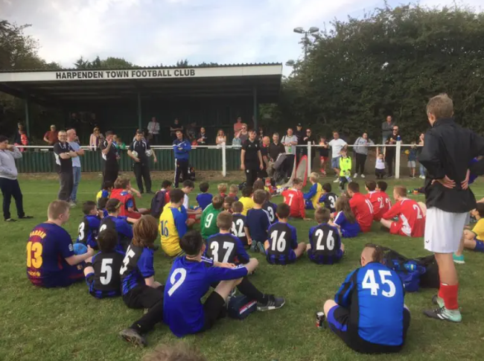
Social Action Idea
Organise a fun and competitive charity sports match – football, netball, cricket, or rounders – with students taking on staff in a much-anticipated showdown!
Raise funds through "pay to play" entry fees, audience ticket sales, or by setting up stalls selling refreshments and snacks
Add extra excitement with team colours, halftime challenges, or a commentator to keep the crowd entertained
Impact
Consider where you will get the equipment from to run this event...
Remember to ask permission from the Head of Department in advance of it taking place!
An energetic and inclusive way to bring the school community together in support of a great cause
This event is a great way to build school spirit while promoting the importance of active lifestyles
Final Thoughts...
Sport and Recreation

Slide 30
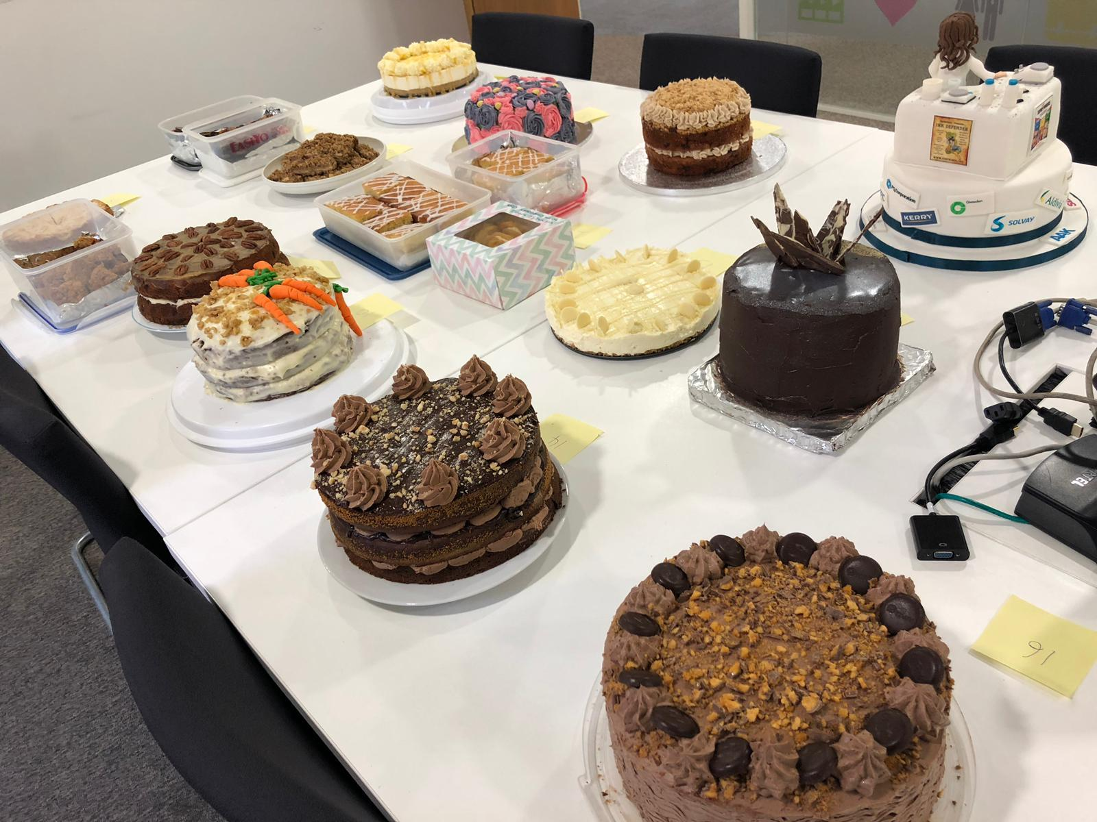
Social Action Idea
Organise a bake sale with a twist! Instead of money, ask students and staff to bring a non-perishable food item or essential toiletry in exchange for a baked good
Encourage homemade bakes and involve different year groups in baking, decorating, or running the stall
You could also add a recipe card station or "bake and donate" competition to boost involvement
Impact
A fun, delicious way to raise awareness of food poverty while making a real impact in your local community.
All collected items will be donated to a local foodbank or poverty relief charity within your local community
Promote and advertise this event around your school for maximum impact and footfall!
Final Thoughts...
UK Poverty Relief

Slide 31


Inspiration and Advice from the First Give team...
Find something that genuinely excites you!
Make the most of the variety of skills within your team
Work together and share out tasks equally
Listen to each other's viewpoints
Use your teachers as a source of support with organising social actions
Be prepared to face some challenges – it's not always easy, but it will be worth it!
Always link your social action back to your chosen social issue
Most Importantly...
Enjoy it! This is a unique opportunity to do something amazing!
Social Action Matrix 1
Social Action Matrix 2
Final Thoughts

