Slide 2
22
Presentation guidelines
Your presentation should:

Slide 3
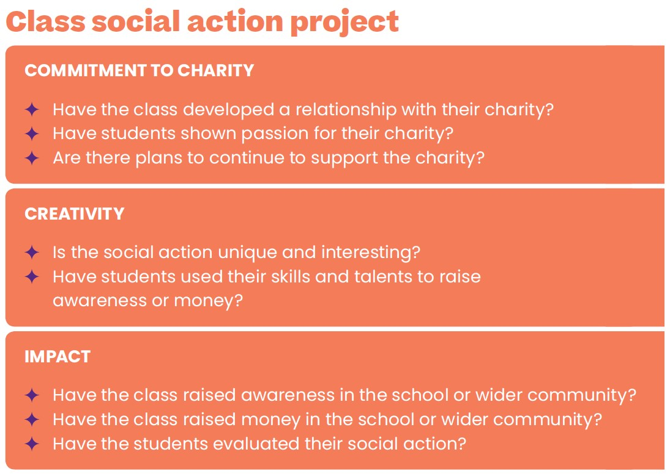
23
Judges’ criteria

Slide 4
24-29
Watch the video
Your teacher will pause halfway through the video so you can think about what content your presentation should include.
After the second half of the video, you’ll think about how to deliver this content creatively.

Slide 6
24-29
Presentation planning
Use the content cards to structure and plan your presentation. Discuss in your group who is responsible for each section of your presentation. Make sure all rows of the tables are filled out.

Slide 7
N/A
After this lesson, how would you rate your:
Project planning skills?
Leadership skills?
Teamwork skills?
Discuss in pairs

Slide 8
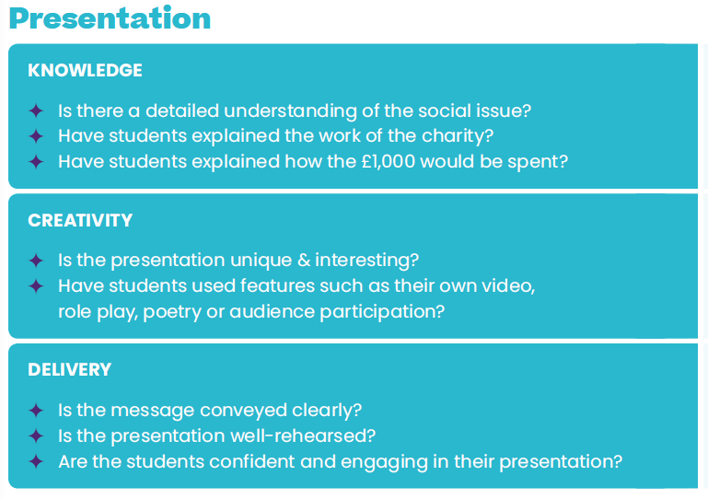

Slide 9
