Slide 1
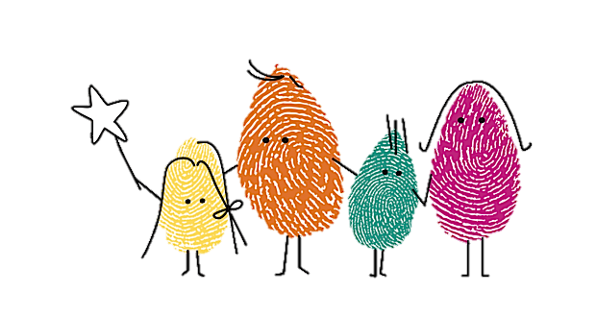
Shooting Star Chase
Children deserve a full life
‘Make every moment count’

Slide 2
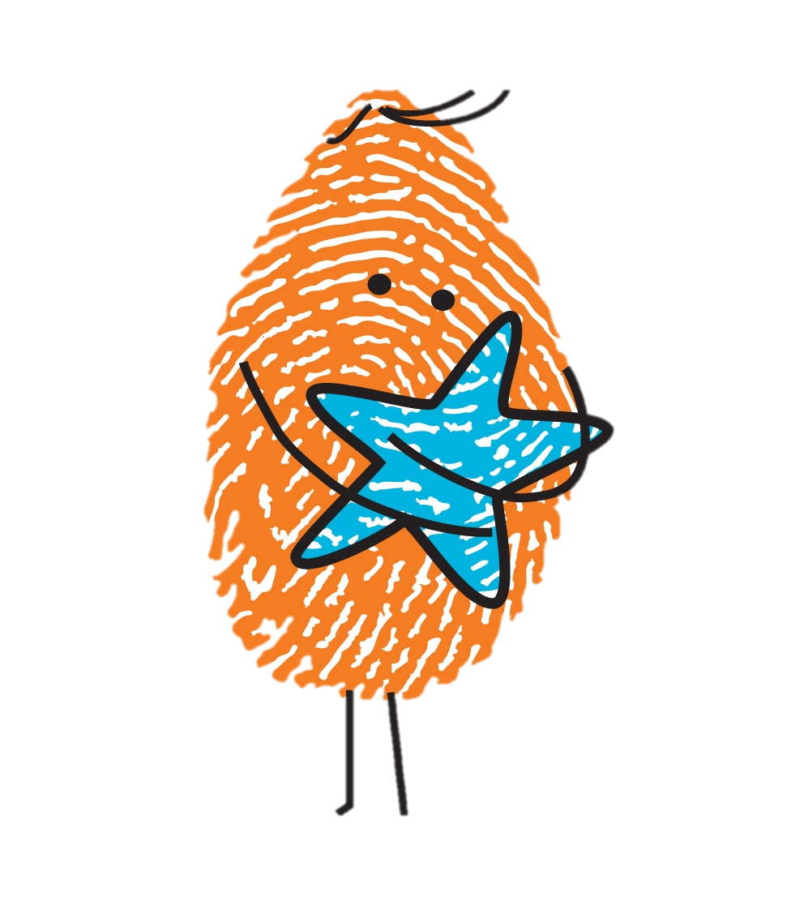
Shooting Star Chase
About
Shooting Star Chase is a leading children’s hospice charity for babies, children and young people with life-limiting conditions, and their families. Whether lives are measured in days, weeks, months or years, they are here to make every moment count. They support families from diagnosis to end of life and throughout bereavement with a range of nursing, practical, emotional and medical care. Their care service includes short breaks at their two hospices (Shooting Star House in Hampton and Christopher’s in Guildford).
Contact
Shooting Stars Chase
t 01932 823100
w shootingstarchase.org.uk
e hello@shootingstarchase.org.uk

Slide 3
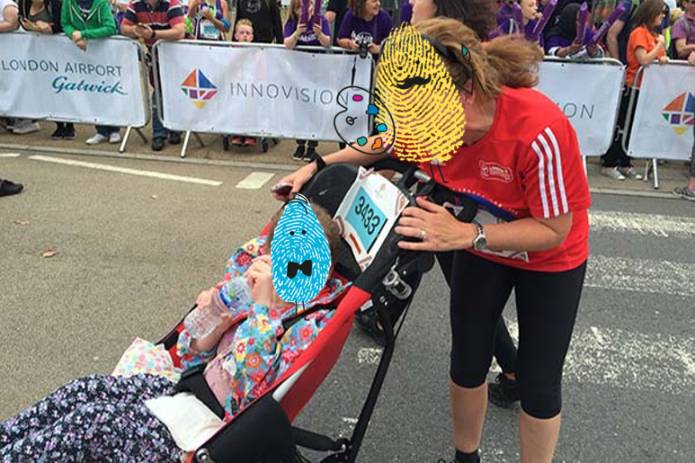
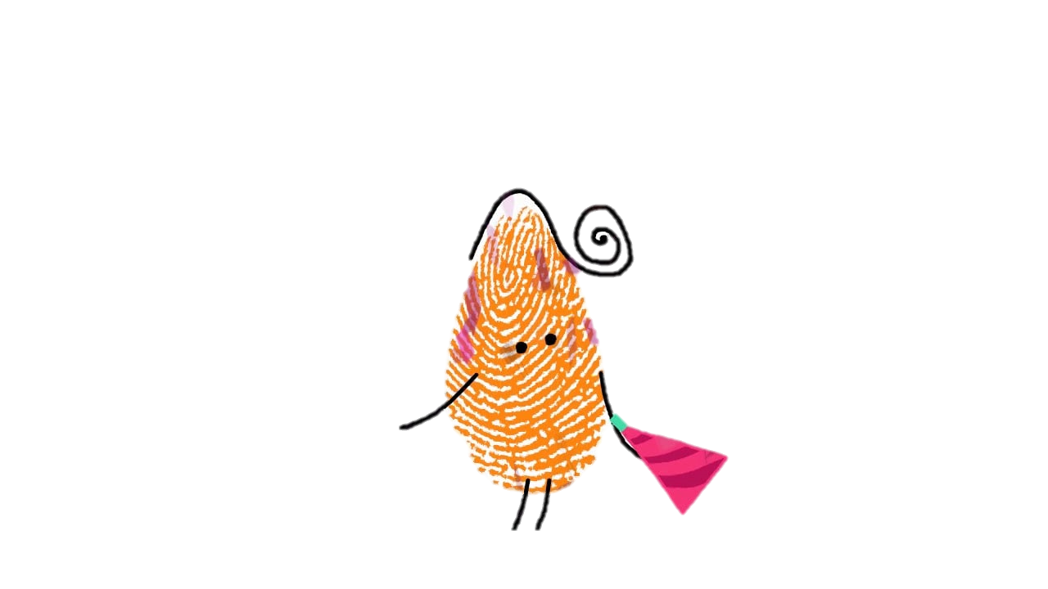
Daisy’s Story

Slide 4
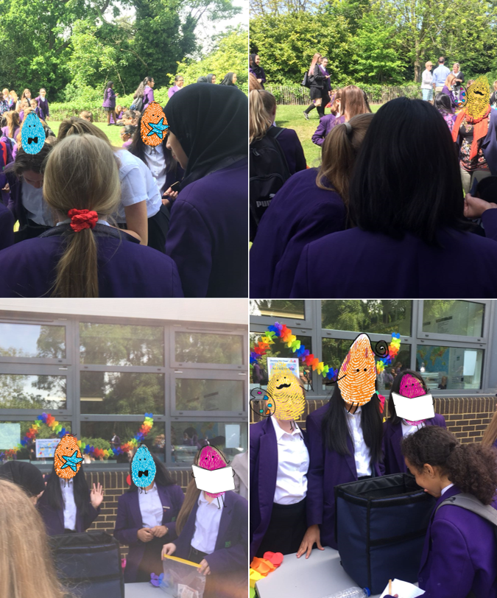
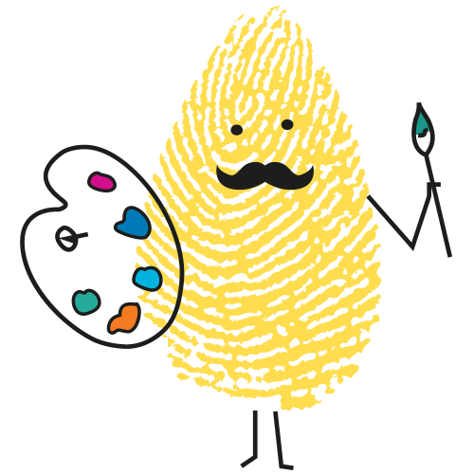
Our Social Action
For our social action, we decided to sell ice lollies. Overall, we raised approximately £40 yet the lollies were sold out within 10 minutes!

Slide 5
Facts and Stats
It costs £10 million a year just to maintain their current level of care. 10% comes from the government so they rely on the generosity of supporters to keep the service running. There are more families desperate for their care so £1000 could pay for an activity day for bereaved siblings. These days provide opportunities to explore feelings.

