Slide 2
33-34
Evaluating our social action
Use the grid on page 33 and questions on page 34 of your coursebook to evaluate your social action.

Slide 3
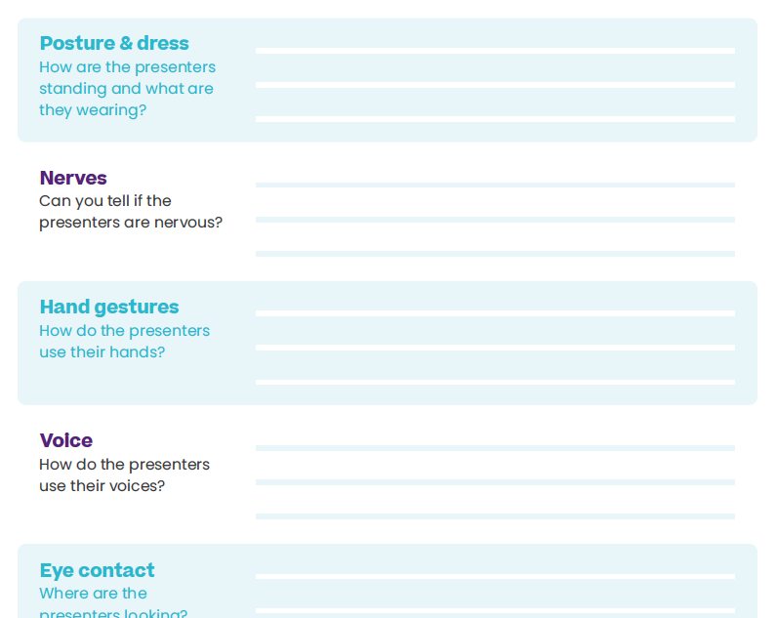
35
What does “good” look like?
Your teacher will play you a video of a group of students delivering their First Give presentations.
Watch the presentation video and write down your observations in the table on page 35 of your coursebook.

Slide 4
N/A
Rehearse your presentation
Think about the following:
How are you using the skills you just saw in the video?
Does your presentation meet the judges’ criteria?
Will your presentation stand out from all the others?
Make sure you have sent any slides to your teacher

Slide 5
N/A
After this lesson, how would you rate your…
Presentation skills?
Discuss in pairs

