Slide 1

Class Display Projects
Notes:
Here are some additional activities

Slide 2
You may have some lesson time while your class representatives hone their presentation for the School Final.
Here are two fantastic class activities which students can do to add value to the presentation and make the Final a special event.
Class Display Board
School Final Bunting
Class Display Projects

Slide 3
Task:
To support your presenting team, create a Class Display Board which can be displayed at the First Give Final.
You could include:
Charity and school logos
Photos of any charity visit/communications
Statistics or facts about your social issue – don’t forget your ‘why’!
Testimonial or case study quotes
Quizzes or interactive elements
Photos and outlines of your social action activities
Amount of money raised through social action, or other evaluation measurements
Class Display Board

Slide 4
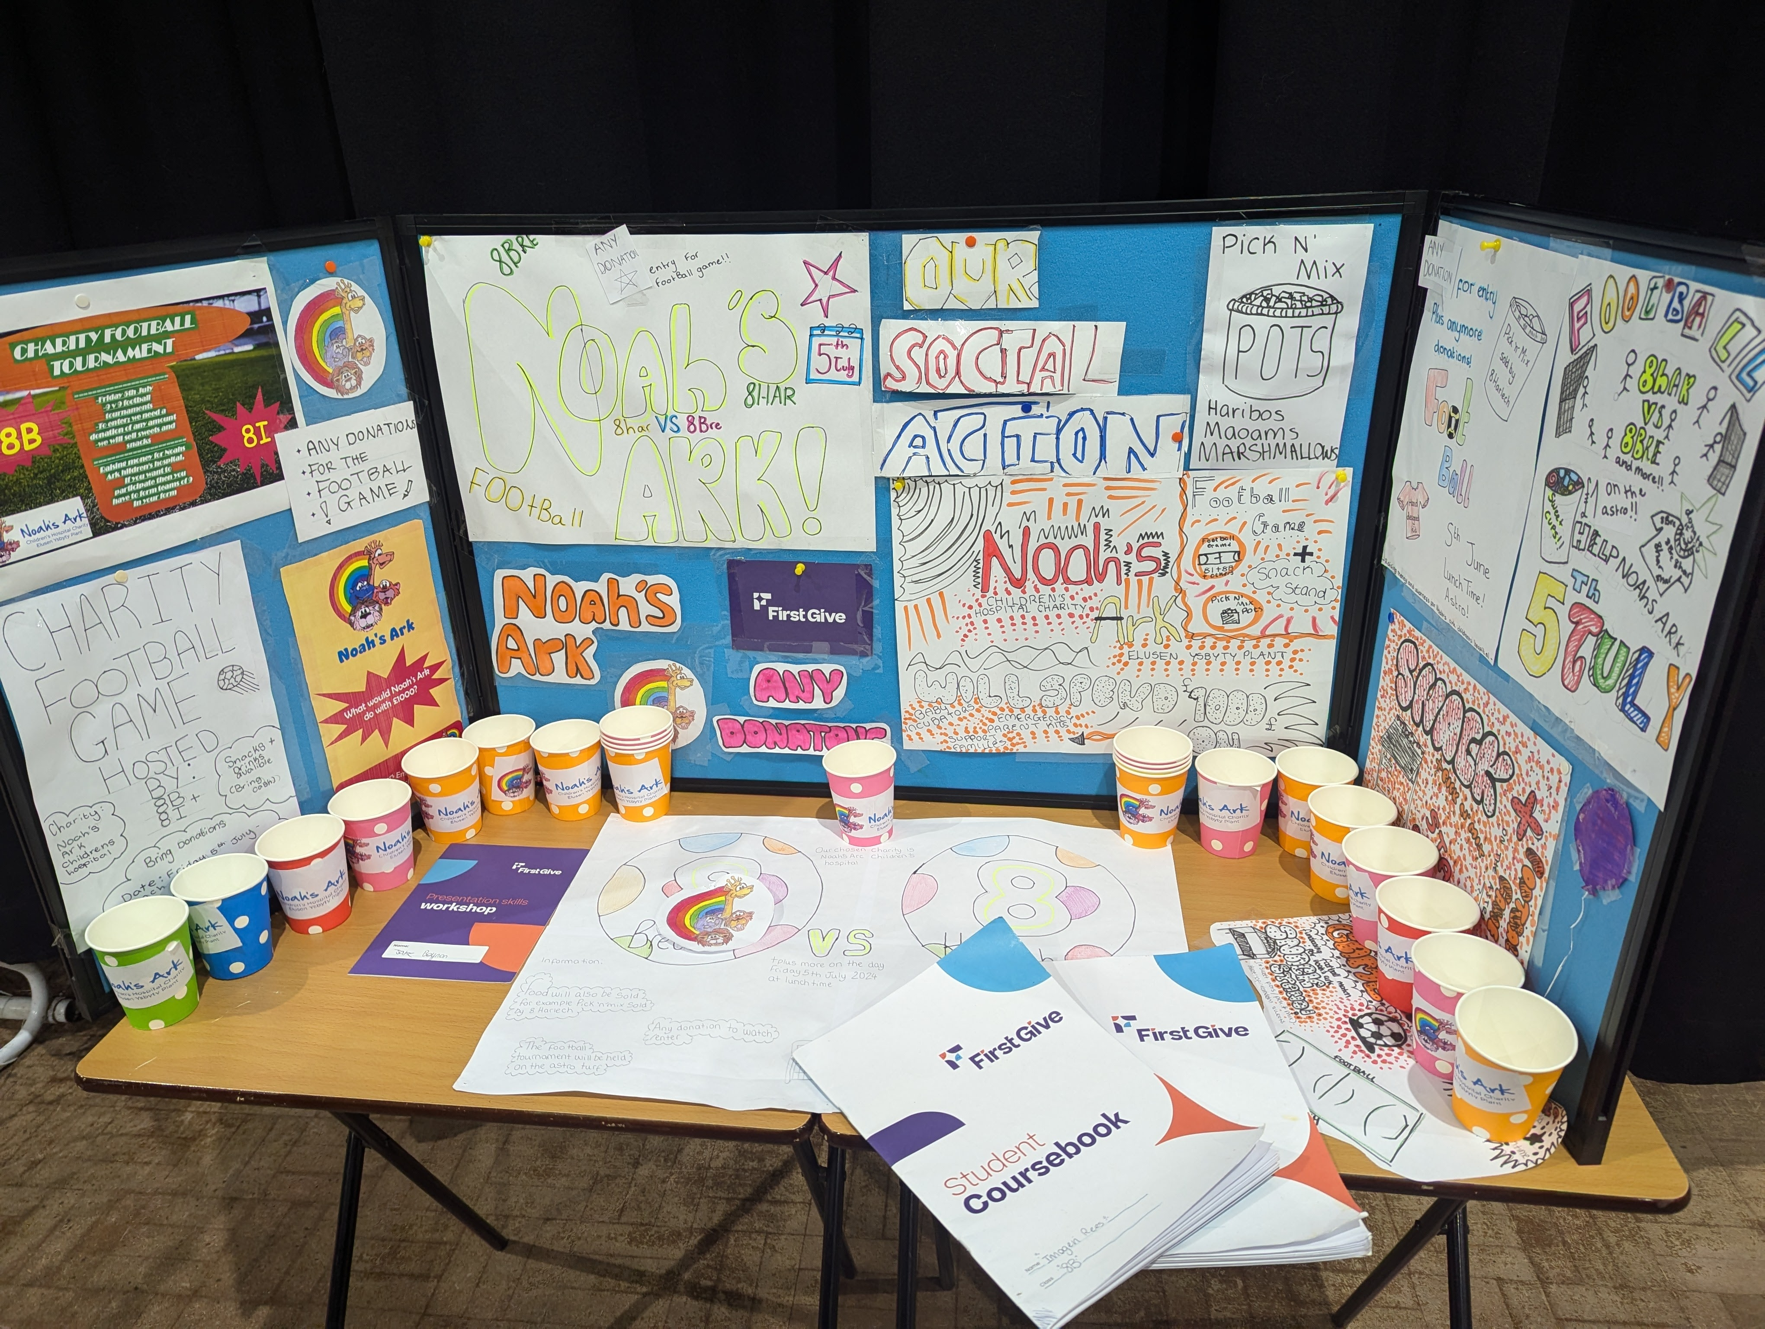
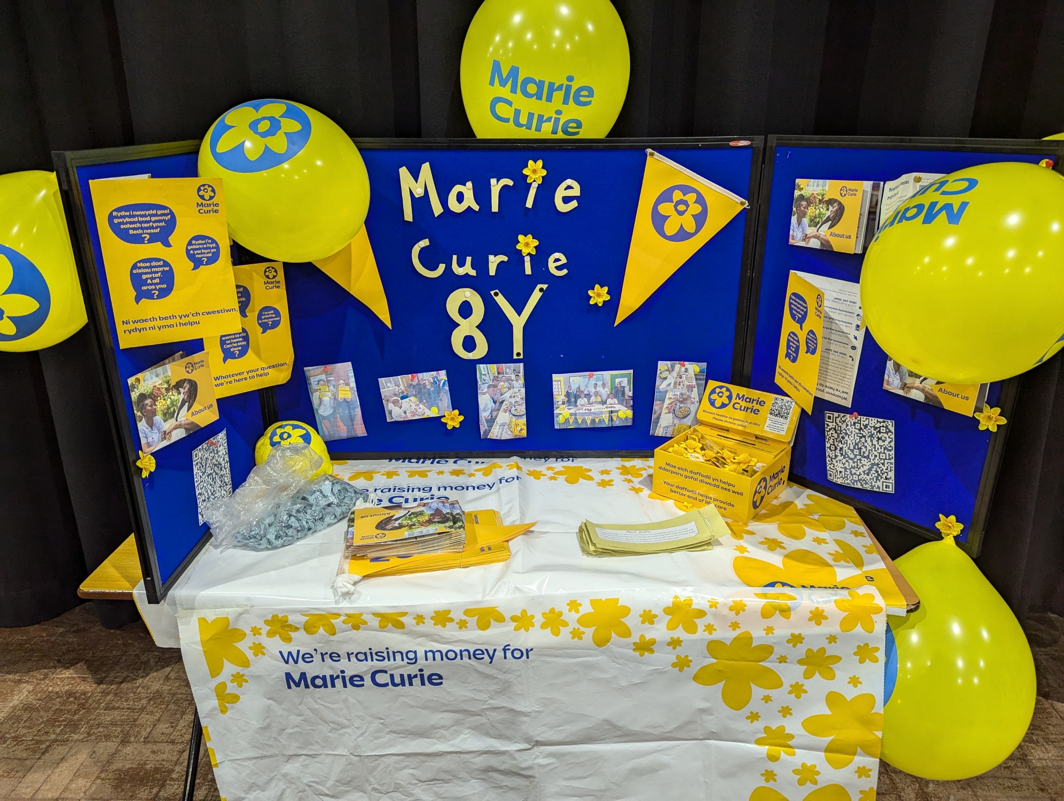
Examples

Slide 5
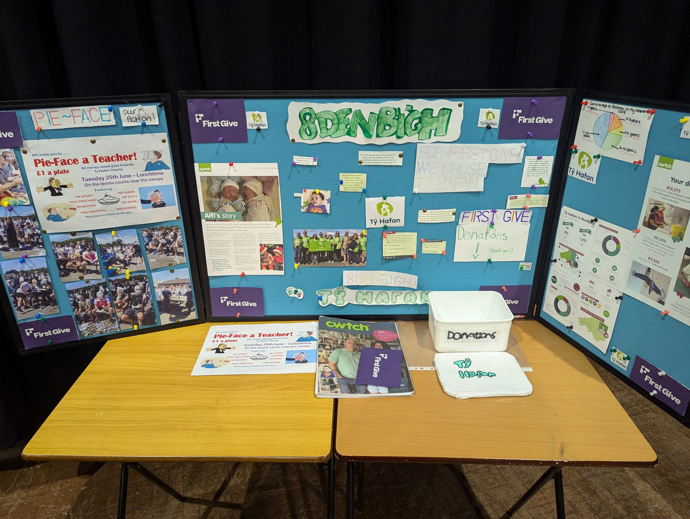
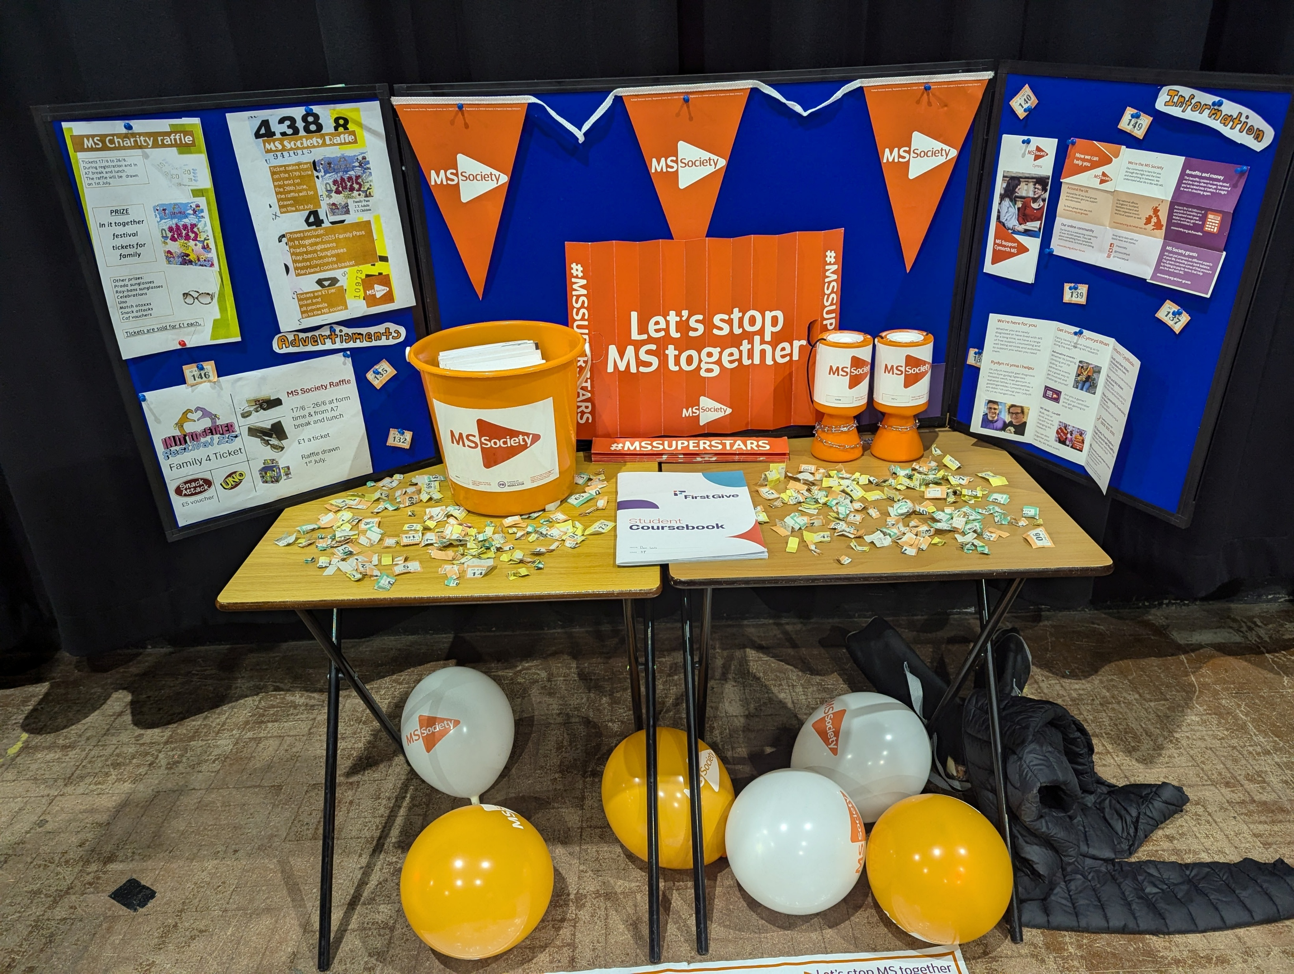
Examples

Slide 6
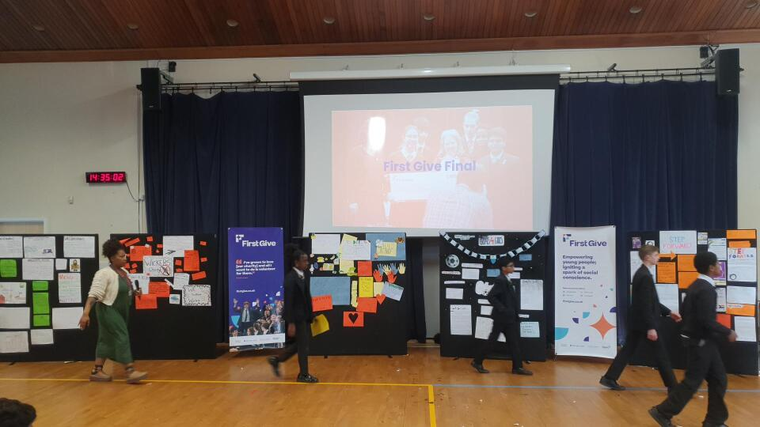
Examples

Slide 7
Task:
Decorate your First Give Final venue by creating themed bunting (this could be done across all classes!)
You could include:
Charity logo
Notable statistics – either about your social issue, or your charity’s impact
Amount of money raised, or other evaluation measurements
Top tips:
Use charity colours to stay on brand
Think creatively – how else could you make the bunting stand out?
School Final Bunting

Slide 8
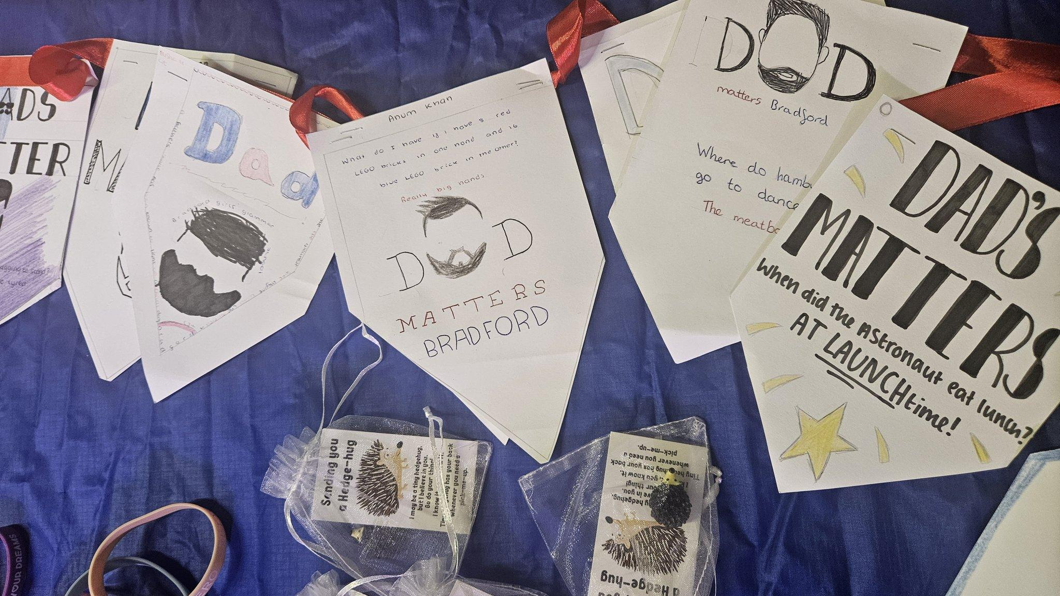
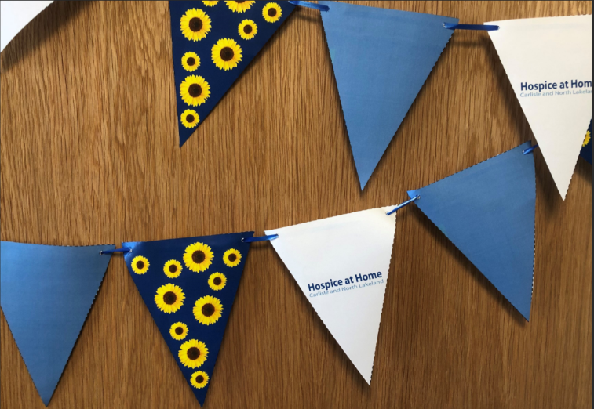
Examples

Slide 9

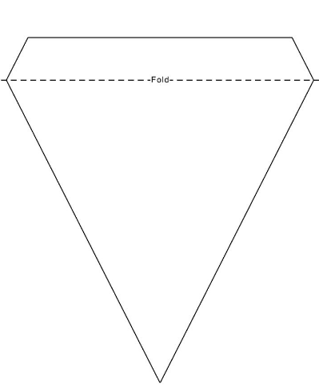
Bunting template suggestions

