Slide 1
Notes:
Thank you for leading a class through the First Give programme.
After you’ve finished Lesson 8 we’d be grateful if you could complete our teacher survey, which should take all of 3 mins:
First Give - Teacher Survey - 2025-26 – Fill in form

Slide 2
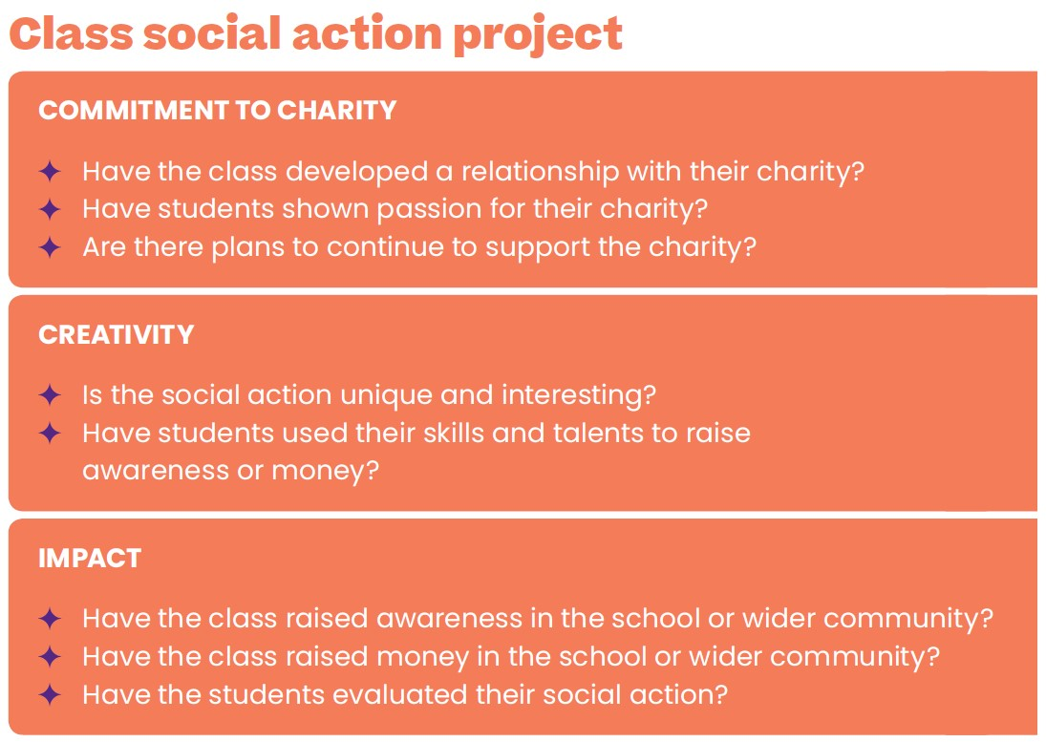
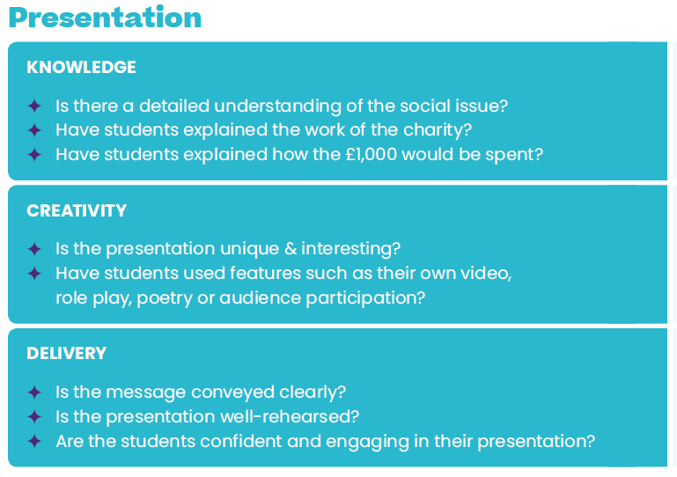

23
Judges’ criteria

Slide 3
36-37
Choosing our class presentation
  Remind yourself of the judges’ criteria on page 36.
  Your class need to nominate the presentation that you think has the best chance of winning!

Slide 4
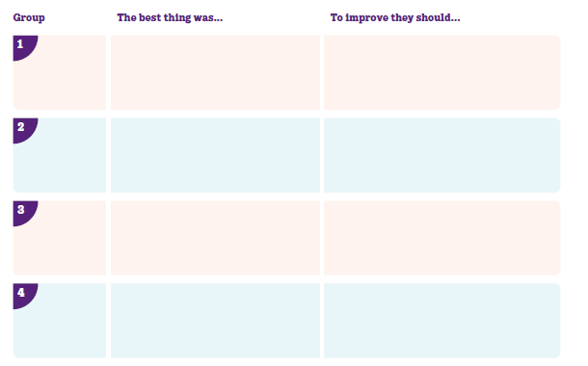
36-37
  Watch the presentations and use the assessment sheet on page 37 alongside the judges’ criteria.
  Write down the best thing and one thing each group could improve in their presentation. Be prepared to feedback.

Slide 5
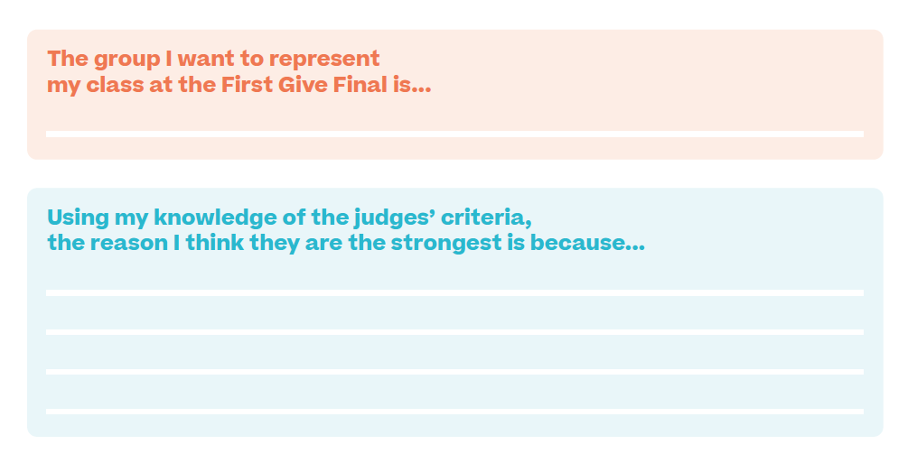
38
Decide which group should represent your class
  Use the space in your coursebook to write down the reasons for your choice.
  Your teacher will help the class vote on which group should present.

Slide 6

38
CHARITY NAME HERE

Slide 7
38
Time to collaborate
  Refer to the table on page 37 and share your suggestions for improvement with the chosen presenting team.
  Your focus here is to make sure the Final presentation has all the best elements from the class’ presentations.

Slide 8
39
Our First Give Final date and time is:
_______________________________
  Now read through the checklists on page 39 and ensure you know what you need to do before the Final.
Notes:
A note for teachers: if possible you should provide all of these details to your class now, and advise the presenting group that they will attend a Presentation Skills Workshop with First Give before the Final.

Slide 9
39
After this lesson, how would you rate your…
    Presentation skills?
Discuss in pairs

