Slide 1
Notes:
Safeguarding: During the course of this lesson students are asked to discuss social issues. We strongly recommend setting clear ground rules around how to discuss such issues sensitively. Students in your class may have been directly or indirectly affected by the social issues being discussed, and in some cases, students may make a disclosure which should be reported through your school’s safeguarding procedures.

Slide 2
3
Watch the videos
Write down:
    One thing you’ve learnt
    One question you have about what you have seen

Slide 3
3
What is a social issue?
  Based on what you know so far, what do you think the definition of a social issue is?
Write down your class definition of a social issue.
Notes:
Recommended social issue definition: “Social issues are problems that affect members of a community or society as a whole”

Slide 4

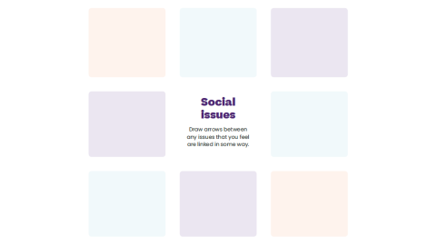

4
Identify causes and make links
  Listen to the case study. When you identify a social issue, write it in your coursebook.
  Draw arrows between any issues you feel are linked in some way.

Slide 5
5
Who’s responsible?
  For this activity, choose one social issue to focus on.
  In pairs, discuss how the groups on page 5 of your coursebook should address your chosen social issue.

Slide 6
6
Which social issues can you identify in your area?
  You have one minute to work with a partner to list three social issues you’ve noticed in your local community. Be prepared to feed back.
Click to start the timer bar

Slide 7
6
What’s our issue?
  As a class, now decide on one issue that you’ll focus on as a priority.
  Your teacher will help the class to decide by leading a discussion and a vote.

Slide 8
7
After this lesson how would you rate your…
    Understanding of social issues?

Slide 9
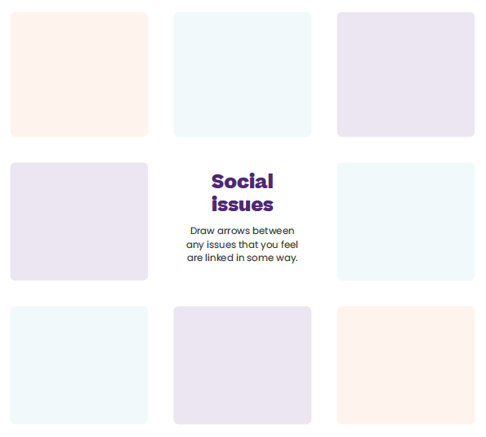

Slide 10
Notes:
A note on charities. In order to be eligible to receive the £1,000 First Give grant charities must be registered with the Charity Commission of England and Wales. The charities chosen must benefit people within the community, who are affected by the social issue chosen in lesson 1. Animal charities should therefore not be selected.
After this lesson please get in contact with the charity that the class has chosen as soon as possible to organise for a representative of the charity to meet the class. To help with arranging this meeting please use these two documents, which can be found on the Teacher Hub:
- Guidance for organising the charity visit
- Template email to charity

Slide 11
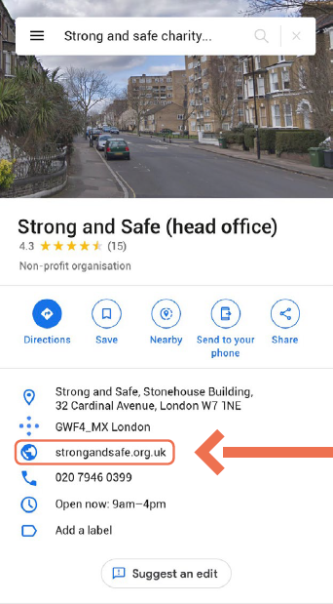

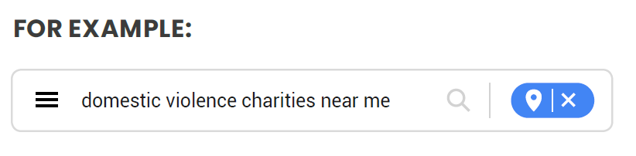

8
1. Finding a charity near you
  www.google.com/maps
  Go to Google Maps and type in what you’re looking for:
2. Click on the charity you want to look at
  Their details will show up on the left panel.

Slide 12
8
3. Click on their website
  Use this method to look at a few charity websites to ensure you find the right charity for you.
  Once you have chosen a charity, you need to check it is registered on the Charity Commission website – follow the steps on the next slide.
1. Finding a charity near you
  www.google.com/maps
  Go to Google Maps and type in what you’re looking for:
2. Click on the charity you want to look at
  Their details will show up on the left panel.

Slide 13

9
3. Click on their website
  Use this method to look at a few charity websites to ensure you find the right charity for you.
  Once you have chosen a charity, you need to check it is registered on the Charity Commission website – follow the steps on the next slide.
2. Click on the charity you want to look at
  Their details will show up on the left panel.
4. Look for the registered charity number
  This is usually found at the bottom of the “About us” page, or the “Donate” page.

Slide 14
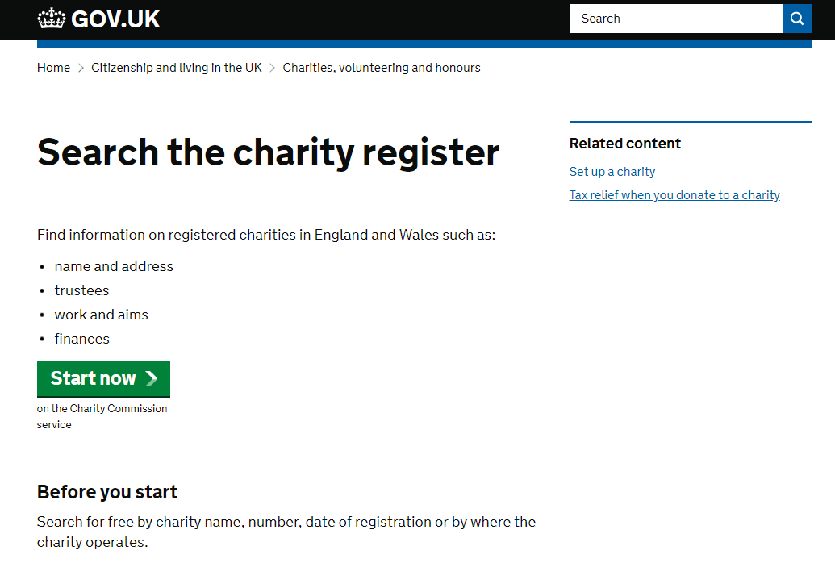
9
5. Go to the Charity Commission website
  https://www.gov.uk/find-charity-information
  Click on “Start Now”.
  Using the search box, enter the charity number you found on the website and click the search icon.
3. Click on their website
  Use this method to look at a few charity websites to ensure you find the right charity for you.
  Once you have chosen a charity, you need to check it is registered on the Charity Commission website – follow the steps on the next slide.
4. Look for the registered charity number
  This is usually found at the bottom of the “About us” page, or the “Donate” page.

Slide 15
10
5. Go to the Charity Commission website
  https://www.gov.uk/find-charity-information
  Click on “Start Now”.
  Using the search box, enter the charity number you found on the website and click the search icon.
4. Look for the registered charity number
  This is usually found at the bottom of the “About us” page, or the “Donate” page.
6. When on your charity page, check it is green
  If there is a red cross, this suggests the charity may not be run efficiently.

Slide 16
10
5. Go to the Charity Commission website
  https://www.gov.uk/find-charity-information
  Click on “Start Now”.
  Using the search box, enter the charity number you found on the website and click the search icon.
6. When on your charity page, check it is green
  If there is a red cross, this suggests the charity may not be run efficiently.

Slide 17
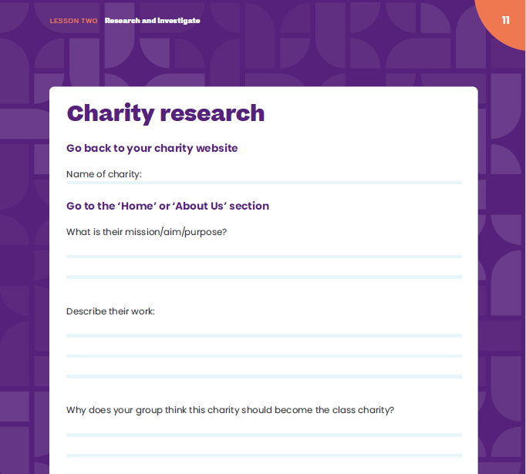
11
Charity research
  Go back to your charity website.
  In your group decide on one charity you think the class should choose to be the class charity and complete the details on page 11.

Slide 18
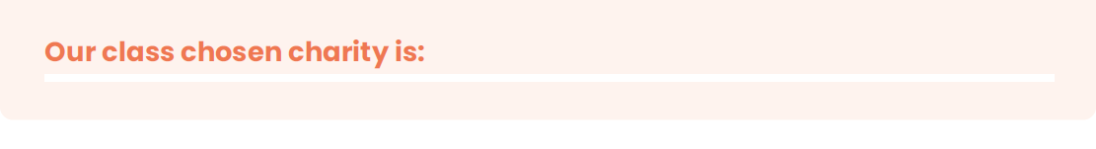
11
Your charity
  Each group will tell the class about their suggested charity. The class will then decide together on one charity…
Notes:
A note for teachers on charities. In order to be eligible to receive the £1,000 First Give grant charities must be registered with the Charity Commission of England and Wales. The charities chosen must benefit people within the community, who are affected by the social issue chosen in lesson 1. Animal charities should therefore not be selected.

Slide 19
11
After this lesson, how would you rate your…
    Research skills?
    Group decision-making skills?

Slide 21
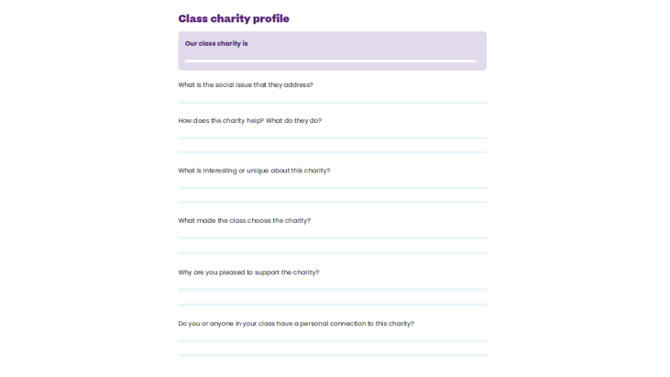
12-13
Our class charity
  We are going to create a class charity profile together using the charity website.
  Look at the website as a class and fill out the class charity profile on pages 12-13 of your coursebook.

Slide 22
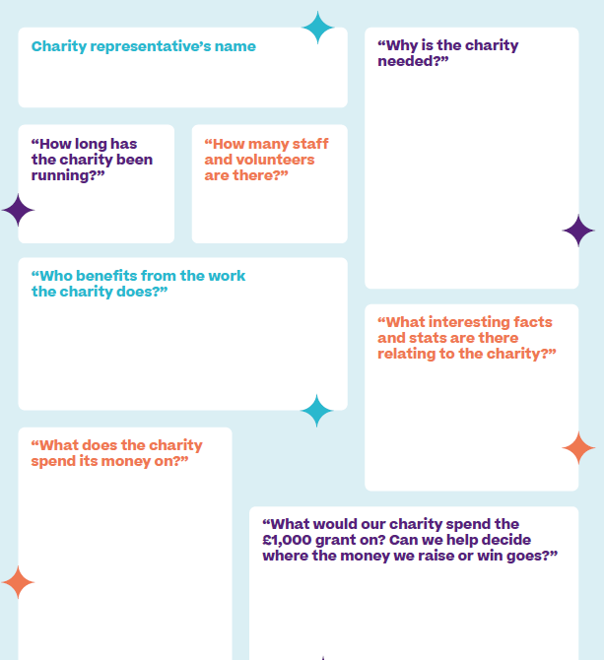
13-15
Charity meeting
  Make sure you gather all the information you can to help plan your social action and to include in your presentation.
  Use the questions on pages 14-15 and don’t forget to ask any questions you came up with on page 13.

Slide 23
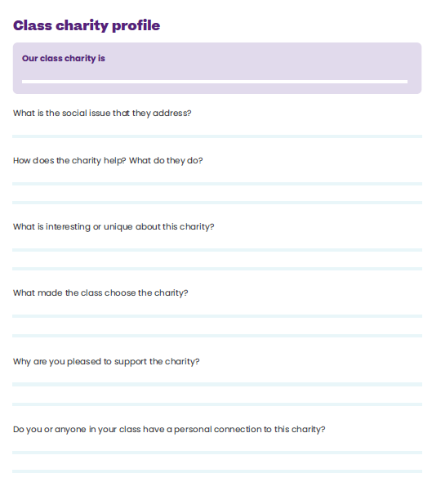

Slide 25


16
What is social action?
  Watch the video

Slide 26


Slide 27
16
What is social action?
  Social action is…
  Practical action taken to make a positive change in society.
  For example, fundraising or raising awareness.

Slide 28
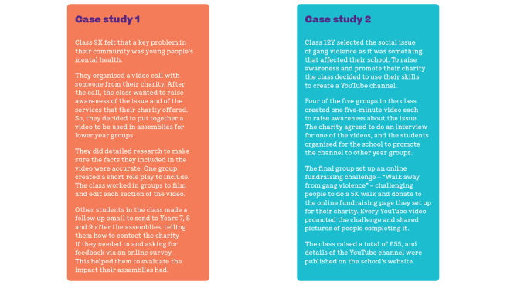
16-17
What makes social action successful?
  Read through both case studies and answer the questions on page 17 of your Coursebook.

Slide 29
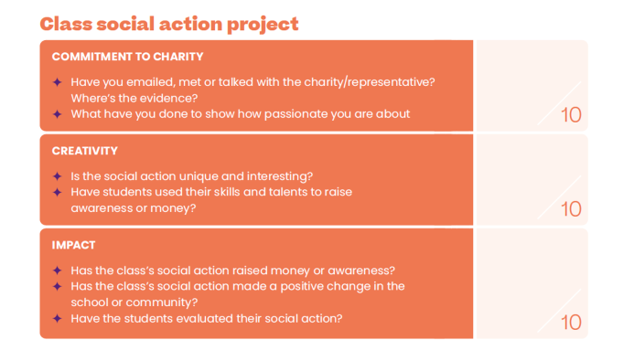
23
Judges’ criteria
  When the judges make their decision at the Final, 50% of the marks they award will be for your class’ social action.
  You can find these criteria on page 23 of your coursebook. Keep them in mind when planning your social action.

Slide 30


18-19
Your aim
  In groups, use the planner on page 18 to think about what you want to achieve.
Your planner
  What is your aim?
  How will you work as a team?
  How will you know you’ve been successful?
  Use the planner on page 19 of your coursebook.

Slide 31
21
After this lesson, how would you rate your…
    Project planning skills?
    Leadership skills?
    Teamwork skills?

Slide 32
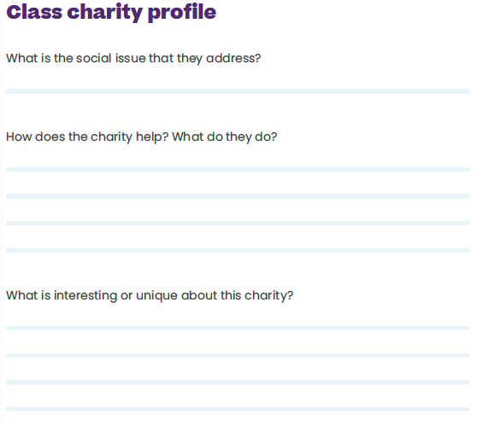

Slide 33
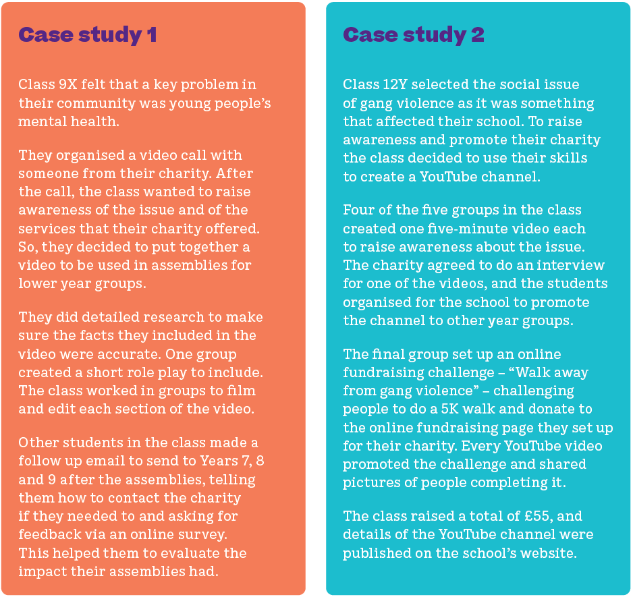

Slide 34
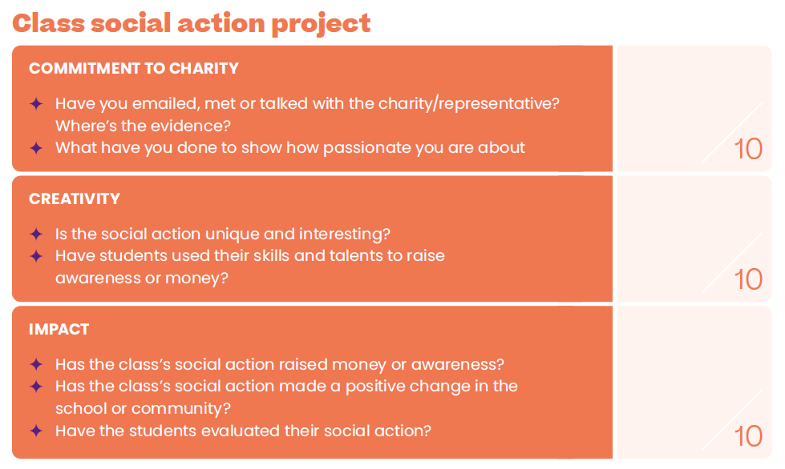

Slide 36
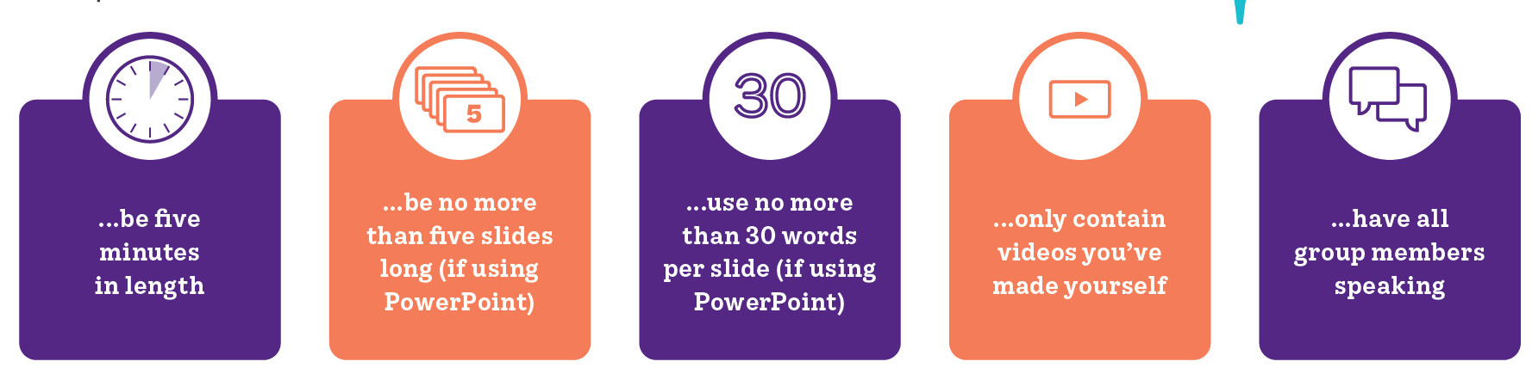
22
Presentation guidelines
  Your presentation should…

Slide 37
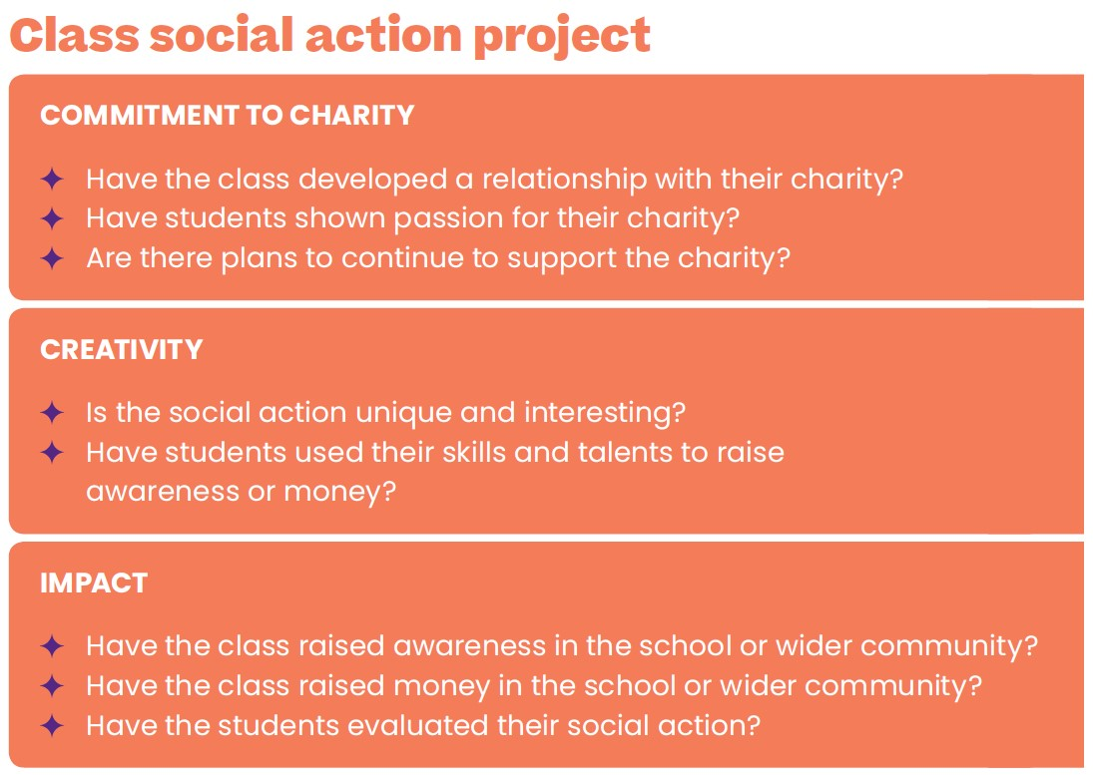
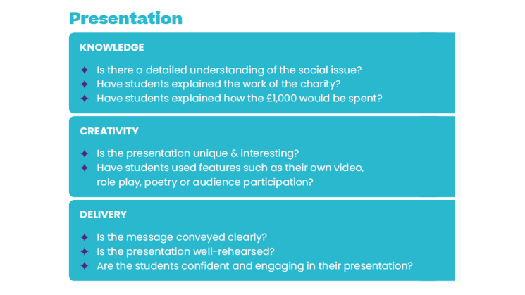
23
Judges’ criteria

Slide 38

24-29
Watch the video
  Your teacher will pause halfway through the video so you can think about what content your presentation should include.
  After the second half of the video, you’ll think about how to deliver this content creatively.

Slide 39


Slide 40
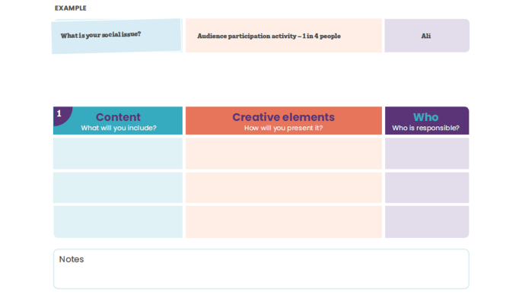
24-29
Presentation planning
  Use the content cards to structure and plan your presentation.
  Discuss in your group who is responsible for each section of your presentation.
  Make sure all rows of the tables are filled out.

Slide 41
N/A
After this lesson, how would you rate your:
    Project planning skills?
    Leadership skills?
    Teamwork skills?
Discuss in pairs

Slide 42
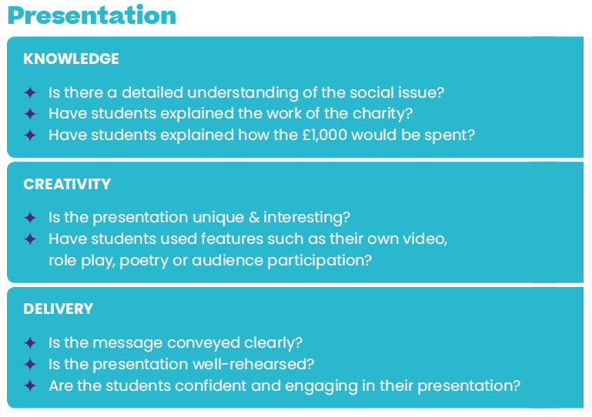

Slide 43
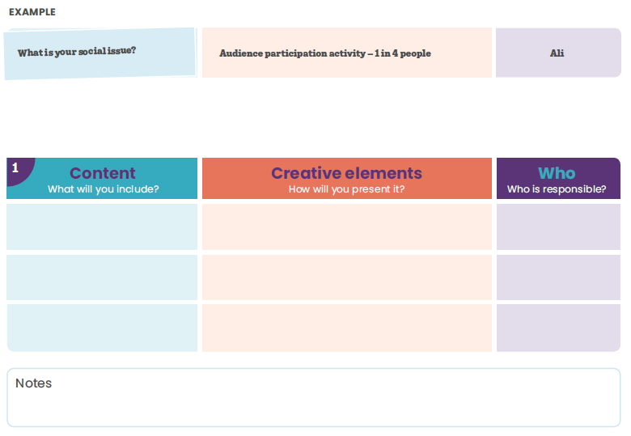

Slide 45

33-34
Evaluating our social action
  Use the grid on page 33 and questions on page 34 of your coursebook to evaluate your social action.

Slide 46
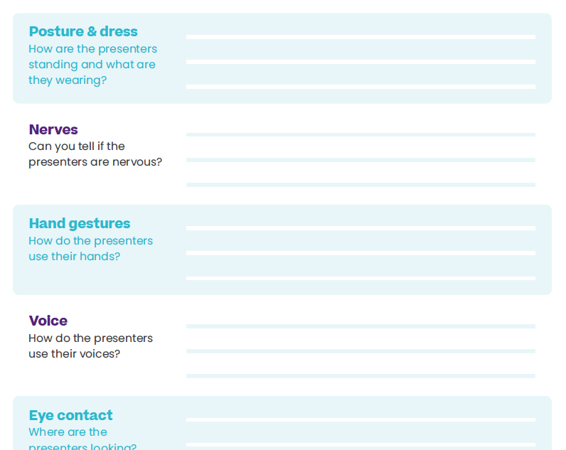
35
What does “good” look like?
  Your teacher will play you a video of a group of students delivering their First Give presentations.
  Watch the presentation video and write down your observations in the table on page 35 of your coursebook.

Slide 47
N/A
Rehearse your presentation
  Think about the following:
    How are you using the skills you just saw in the video?
    Does your presentation meet the judges’ criteria?
    Will your presentation stand out from all the others?
    Make sure you have sent any slides to your teacher

Slide 48
N/A
After this lesson, how would you rate your…
    Presentation skills?
Discuss in pairs

Slide 50
23
Judges’ criteria

Slide 51
36-37
Choosing our class presentation
  Remind yourself of the judges’ criteria on page 36.
  Your class need to nominate the presentation that you think has the best chance of winning!

Slide 52
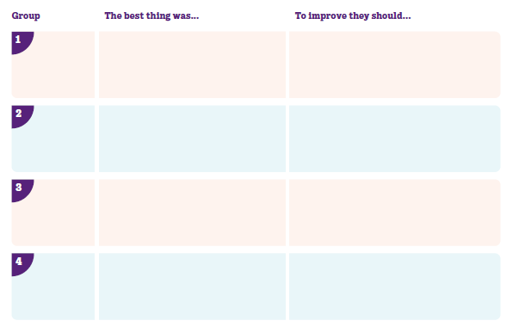
36-37
  Watch the presentations and use the assessment sheet on page 37 alongside the judges’ criteria.
  Write down the best thing and one thing each group could improve in their presentation. Be prepared to feedback.

Slide 53
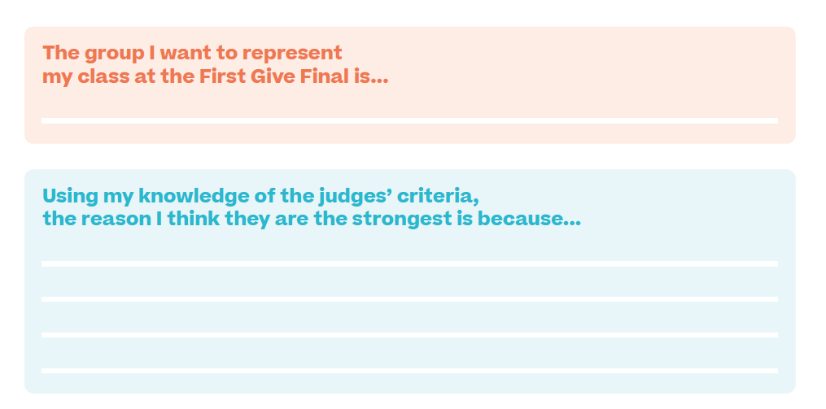
38
Decide which group should represent your class
  Use the space in your coursebook to write down the reasons for your choice.
  Your teacher will help the class vote on which group should present.

Slide 54

38
CHARITY NAME HERE

Slide 55
38
Time to collaborate
  Refer to the table on page 37 and share your suggestions for improvement with the chosen presenting team.
  Your focus here is to make sure the Final presentation has all the best elements from the class’ presentations.

Slide 56
39
Our First Give Final date and time is:
_______________________________
  Now read through the checklists on page 39 and ensure you know what you need to do before the Final.
Notes:
A note for teachers: if possible you should provide all of these details to your class now, and advise the presenting group that they will attend a Presentation Skills Workshop with First Give before the Final.

Slide 57
39
After this lesson, how would you rate your…
    Presentation skills?
Discuss in pairs

